Slide 1
11th Meeting
BAHASA INGGRIS 3

Slide 2
What did you study in the last meeting?
What place is it?
In which country can we find it?

Slide 3
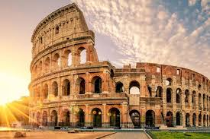

Slide 4
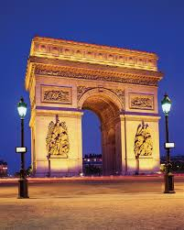

Slide 5
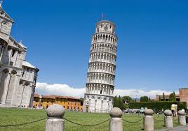

Slide 6
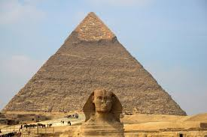

Slide 7
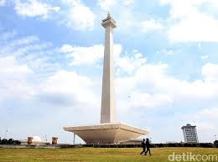
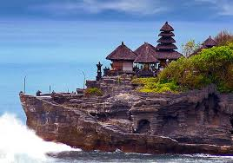

Slide 8
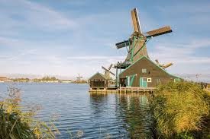

Slide 9
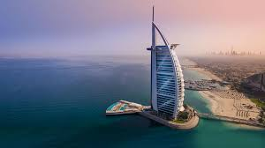

Slide 10
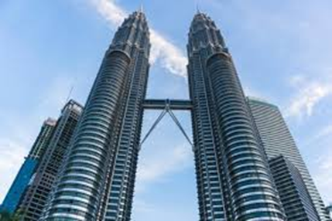

Slide 11
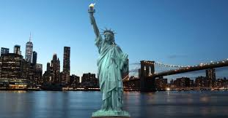

Slide 12
Today’s Topic: Travelling
Objectives
At the end of the meeting, the students will be able to:
Understand main idea of a talk.
Understand the use of simple future tense to make plan.

Slide 13
Where is Ecuador?
Mention countries near Ecuador.
What did Molly do in Ecuador?
How was the host family?
How is the family structure in Ecuador?
What food did Molly find in the morning?
What is Siesta?
What did Molly have for dinner?
What did molly say about Galapagos islands?
What animal we can find in Galapagos?

Slide 14
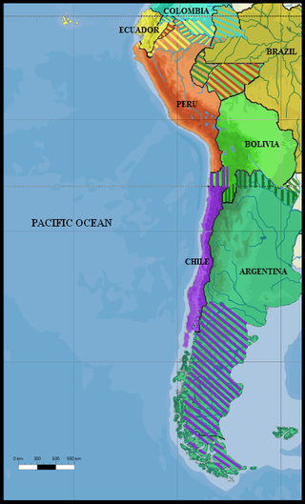

Slide 15
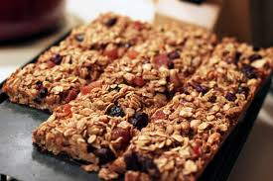
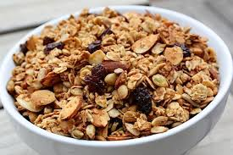
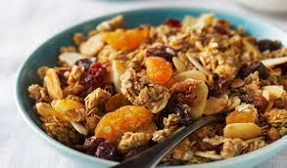

Slide 16
