Slide 1
Public Speaking Skill
Riza Nurhana

Slide 2
Outline
Definition
Functions
Methods
Techniques
Common Problems and Solutions

Slide 3
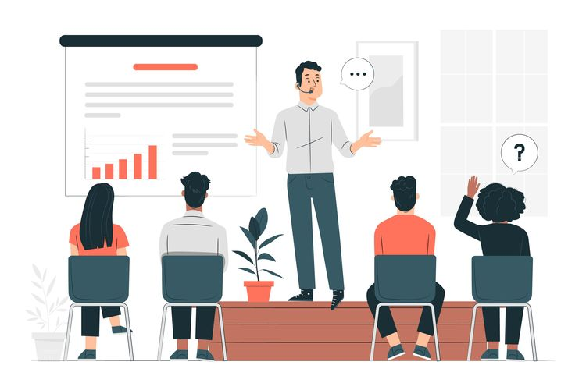
Public Speaking
Public speaking involves talking in front of a group of people, usually with some preparation. It can be in front of people that you know (e.g. at a family celebration) or a crowd of strangers.

Slide 4

Speeches have different functions
Persuasive
e.g. trying to convince the audience to vote for you.
Informative
e.g. speaking about the dangers of smoking.
Entertaining
e.g. a best man’s speech at a wedding.
Celebratory
e.g. to introduce the winner of an award.

Slide 5
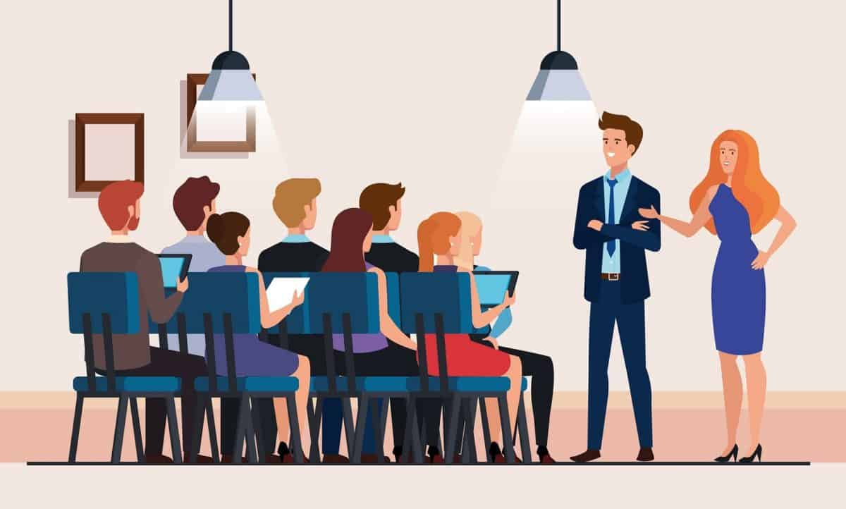
Methods
1. Impromptu or Ad Libitum
It is spontaneous/ without a script.
(+) Natural, spontaneous, honest.
(-) Raw conclusion, unsystematic, and disfluent.
2. Manuscript/ reading complete text
Formal speech
(+) editing time, fluent, prevent unwanted statement, script can be copied.
(-) Less interaction, longer preparation, stiff

Slide 6

Methods
3. Memoriter/ memorizing
It is not recommended for those who have problem in memorizing long sentences.
4. Extempore/ Using note
(+) better communication, flexible, and spontaneous
(-) longer preparation, probability of uninteresting diction, decreased fluency.

Slide 7
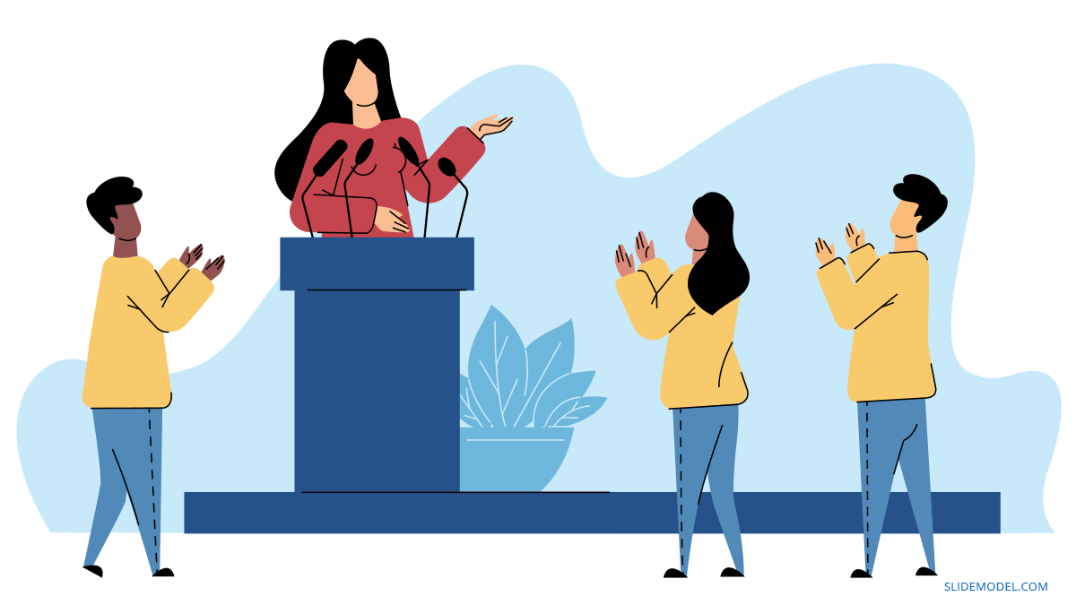
What techniques are used to prepare?
Ideas / content generation
Structure
Body language (Posture, gesture and eye contact)
Chunking (pauses and stress)

Slide 8
Common Problems and Solutions
Lack of confidence
Only practice, practice and more practice will help to overcome.
Breath properly while you’re speaking.
Think positively about your ability to speak well.
Speaking too fast
Appropriacy of body language
Try videoing the speaker and watch the video
Boring speeches
It can be the material or the appropriacy of the style. Think about your audience. Be communicative.
Plagiarism of Material
Use only notes or key words to help you deliver their speech.

Slide 9

Thank You

