Slide 1

5th Meeting
BAHASA INGGRIS 3
February 17th, 2023

Slide 2
Let’s review the previous meeting
What have you learned so far?

Slide 3
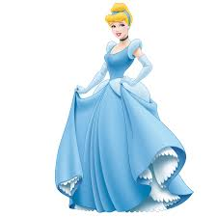
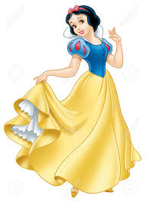
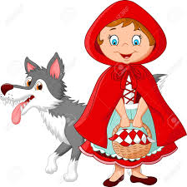
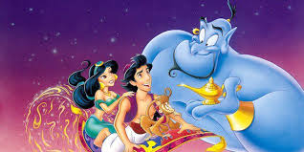

Slide 4
Today’s Topic: Narrative
Objectives
By the end of the meeting, the students will be able to:
Define narrative genre.
Mention kinds of narrative text
Identify the plot of narrative text
Mention language features used in narrative text

Slide 5
What is narrative text?

Slide 6
Narrative is writing that connects ideas, concepts or events.

Slide 7
The use of the narrative text itself has several purposes, such as entertaining, educating, telling, conveying the author's experience or as a medium to develop the imagination of the reader.

Slide 8
Kinds of Narrative Text
Folklore/ folktale
Personal Experience
Fairy Tale
Fable
Legends
Myth
Romance
Mysteries
Science Fiction
Hostorical,etc

Slide 9
Plot
    Exposition- the first part of the story. The author establishes the setting, introduces characters, gives additional background information.
    Rising Action/Complications- the series of conflicts or struggles that build a story toward its climax. Tension rises.
    Climax- the high point, or turning point, of a story. It is the most intense point. A decision is made that will decide the outcome of the conflict.
    Falling Action- the action that works out the decision arrived at during the climax. The conflict is –or begins to be –settled.
    Resolution- the ending. It ties up loose ends and brings the story to a close.

Slide 10
What have you learned today?

Slide 11
Thank you
See you next week
延时符

