Slide 1
LOOK AT THE FOLLOWING PICTURES!

Slide 2
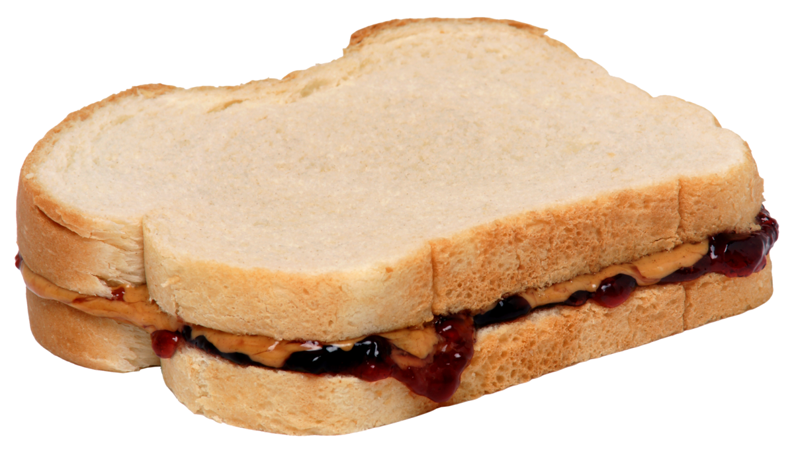


Slide 3
DO YOU KNOW HOW TO MAKE THEM?

Slide 4
PROCEDURE TEXT

Slide 5
FUNCTION
A text to show how to do or to make something.

Slide 6
Type of Procedure Text
Recipe
Manual
What’s the difference?
Look and read the following texts! Compare them!!

Slide 7
HOW TO MAKE PEANUT BUTTER AND JELLY SANDWICH
INGREDIENTS :
two slices of bread,
margarine,
peanut butter,
strawberry jam,
TOOLS :
1.Knife
2. Plate
STEPS :
First, smear the margarine to the slices of bread evenly.
Second, smear peanut butter to one slice of bread.
Third, smear strawberry jam to the other slice of bread.
After that, close the bread.
Next, cut into halves carefully.
Finally, serve it
HOW TO SEND AN E-MAIL
First, we go to gmail or ymail.
Second, we log in to our email account.
After logging in, we click compose, and it will appear a new message box.
Then, in the column “to” we write email address someone that we want to send the file.
Next, write your message
If you want to send file from your computer or device, click “attach file” and click “open”. So, the file is attached.
Finally, click send.

Slide 8
Can you find goal in both texts?
What can you find in the recipe but you cannot find it in the manual?
Why can’t you find it in the manual?
Can you finds steps in both texts?

Slide 9
HOW TO MAKE PEANUT BUTTER AND JELLY SANDWICH
INGREDIENTS :
two slices of bread,
margarine,
peanut butter,
strawberry jam,
TOOLS :
1.Knife
2. Plate
STEPS :
First, smear the margarine to the slices of bread evenly.
Second, smear peanut butter to one slice of bread.
Third, smear strawberry jam to the other slice of bread.
After that, close the bread.
Next, cut into halves carefully.
Finally, serve it
GOAL
HOW TO SEND AN E-MAIL
First, we go to gmail or ymail.
Second, we log in to our email account.
After logging in, we click compose, and it will appear a new message box.
Then, in the column “to” we write email address someone that we want to send the file.
Next, write your message
If you want to send file from your computer or device, click “attach file” and click “open”. So, the file is attached.
Finally, click send.
MATERIALS
OPTIONAL
STEPS

Slide 10
GENERIC STRUCTURE
Goal/ aim/ purpose
Materials (optional)
Steps

Slide 11
LANGUAGE FEATURES OF PROCEDURE TEXT

Slide 12
HOW TO MAKE PEANUT BUTTER AND JELLY SANDWICH
INGREDIENTS :
two slices of bread,
margarine,
peanut butter,
strawberry jam,
TOOLS :
1.Knife
2. Plate
STEPS :
First, smear the margarine to the slices of bread evenly.
Second, smear peanut butter to one slice of bread.
Third, smear strawberry jam to the other slice of bread.
After that, close the bread.
Next, cut into halves carefully.
Finally, serve it
ADVERBS OF SEQUENCE

Slide 13
HOW TO MAKE PEANUT BUTTER AND JELLY SANDWICH
INGREDIENTS :
two slices of bread,
margarine,
peanut butter,
strawberry jam,
TOOLS :
1.Knife
2. Plate
STEPS :
First, smear the margarine to the slices of bread evenly.
Second, smear peanut butter to one slice of bread.
Third, smear strawberry jam to the other slice of bread.
After that, close the bread.
Next, cut into halves carefully.
Finally, serve it
ACTION
VERBS

Slide 14
HOW TO MAKE PEANUT BUTTER AND JELLY SANDWICH
INGREDIENTS :
two slices of bread,
margarine,
peanut butter,
strawberry jam,
TOOLS :
1.Knife
2. Plate
STEPS :
First, smear the margarine to the slices of bread evenly.
Second, smear peanut butter to one slice of bread.
Third, smear strawberry jam to the other slice of bread.
After that, close the bread.
Next, cut into halves carefully.
Finally, serve it!
ADVERBS OF MANNER

Slide 15


