Slide 1




BAHASA INGGRIS 3
2nd Meeting

Slide 2

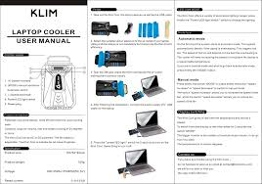


Slide 3
T
Today’s Topic
Introduction to Procedural Text

Slide 4
Objectives
By the end of this course, the students are able to:
• define procedural text
• identify procedural text
• mention generic structure of procedural text
Understand and use imperative sentence and sequencer

Slide 5
Procedural Text
A piece of text that gives us instructions for doing something.
Aim: to explain how something can be done.

Slide 6
Procedural Text
Generic Structure
Aims/goals: An introductory statement that gives the aim or goal
Ingredients/materials: A list of the materials that will be needed for completing the procedure
Steps/methods: A sequence of steps in order they need to be done

Slide 7
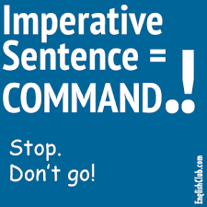

Slide 8
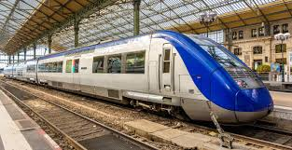
Imperatives
An imperative sentence gives an order, command, advice or request. It tells someone to do something.
1.
A. John is going to miss the train.
B. John, hurry up otherwise you will miss the train.
B

Slide 9
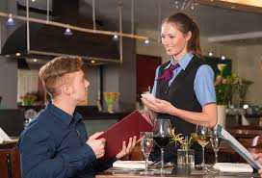
Imperatives
2.
A. Please bring me a glass of water.
B. Do you want a glass of water?
A

Slide 10

Imperatives
3.
A. She is putting her book in the bag.
B. Put your book in the bag, please.
B

Slide 11
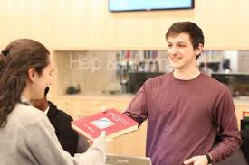
Imperatives
4.
A. Lend me your book, please.
B. He is ready to give me his book.
A

Slide 12

Imperatives
5.
A. Open your mouth, please.
B. She opens her mouth.
A

Slide 13
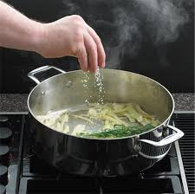
Imperatives
6.
A. You need to add a pinch of salt.
B. Add a pinch of salt to the soup.
B

