Slide 1
TOEIC
STIKES WIDYAGAMA HUSADA MALANG

Slide 2
Outline
01
This Program
02
What is TOEIC?
03
TOEIC Format and Score
04
TOEIC Procedure

Slide 3
What is TOEIC?

Slide 4
Testing
Criterion-Reference Test (CRT)
Achievement Test
Diagnostic Test
Norm-Reference Test (NRT)
Placement Test
Proficiency Test

Slide 5
TOEIC
Test of English for International Communication which aims at assessing English Language Proficiency for non English Native Speaker by using International standard.

Slide 6
Format of TOEIC
Listening (45 Minutes)
Reading (75 minutes)
Part 1: Photograph
(10 questions)
Part 2: Question–Response
(30 questions)
Part 3: Conversations
(30 questions)
Part 4: Talks (30 questions)
Part 5: Incomplete Sentences
(40 questions)
Part 6: Text Completion
(12 questions)
Part 7: Reading Comprehension
Single Passages (28)
b. Double passages (20)

Slide 7
Scoring
Listening : 5-495
Reading : 5-495
This two sub- scores are added to arrive at the total score.
The TOEIC test score is represented on a scale of 10 to 990 and is based on the total number of correct answers.
Target STIKES Widyagama Husada adalah A2-B1 (225-550)

Slide 8
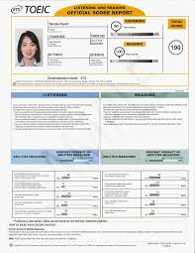
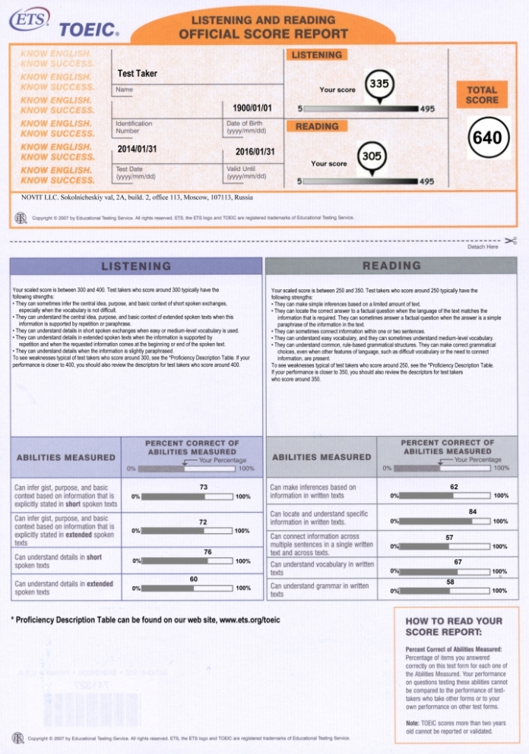

Slide 9
TOEIC in STIKes Widyagama Husada
Klausul :
Setiap Mahasiswa yang lulus tahap akademik DIII/S1 harus mengikuti ujian TOEIC dan menunjukkan sertifikat TOEIC
Preparation Class
sebanyak 2x pertemuan

Slide 10
Procedure
Menyiapkan Pembayaran
Rp. 500.000
Membayar ke Bag. Keuangan
Mengumpulkan fotokopi kwiitansi & KTP
PJMK mendaftar
ke Lab Bahasa

Slide 11
Informasi:
Tes berlangsung di gedung ITC Ruko Jl. Arjuno 20C, Kauman Malang.
Mohon Membawa e-KTP asli/ SIM/ Passport
Alat tulis disediakan pihak ITC
Tidak diperkenankan keluar ruangan ketika tes berlangsung
Score report berlaku 2 tahun
1 kali ujian menampung 12 peserta (sepanjang pandemic COVID-19)

Slide 12
Thank you

