Slide 1

HEALTH SAFETY ENVIRONMENT

Slide 2

Understanding K3
Occupational Health
Occupational health is a health condition which aims to ensure that working people obtain the highest possible level of health, both physical, spiritual and social, by efforts to prevent and treat diseases or health problems caused by work and the work environment as well as general illnesses.

Slide 3
2. Work Safety
Work safety can be interpreted as a condition that avoids danger while carrying out work. In other words, work safety is one of the factors that must be carried out while working.
Whether or not it supports work safety is as follows:
The existence of the elements of occupational safety and health as described above.
There is awareness in maintaining occupational safety and health.
Be thorough in your work
Carry out work procedures by paying attention to occupational safety and health.

Slide 4
3. Job Security
Job security is the supporting elements that support the creation of a safe working atmosphere, both material and non-material.
Material security supporting elements include the following.
Work clothes
Helmet
Glasses
Gloves
Shoes
Non-material security supporting elements are as follows.
Tool manual
Signs and dangers
Appeals
Security officers

Slide 5
The following are some examples of work safety tools:
Safety helmet to protect the head from impacts and falling heavy objects
Seat belt
Boots
Safety glasses
Gloves
Face shield
Life jacket
Respiratory mask
Earplugs to prevent interference that harms the organs in the ear
Gas detector to detect gas in surrounding areas, such as in factories, mines and oil refineries

Slide 6
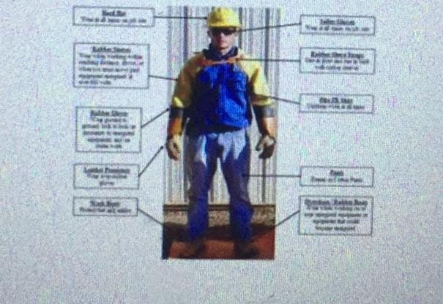
Personal Protective Equipment (PPE)
This is another term for personal protective equipment - PPE is equipment that will protect users against health or safety risks in the workplace. This can include items such as safety helmets and helmets, gloves, eye protection, high visibility clothing, safety shoes and equipment.

Slide 7
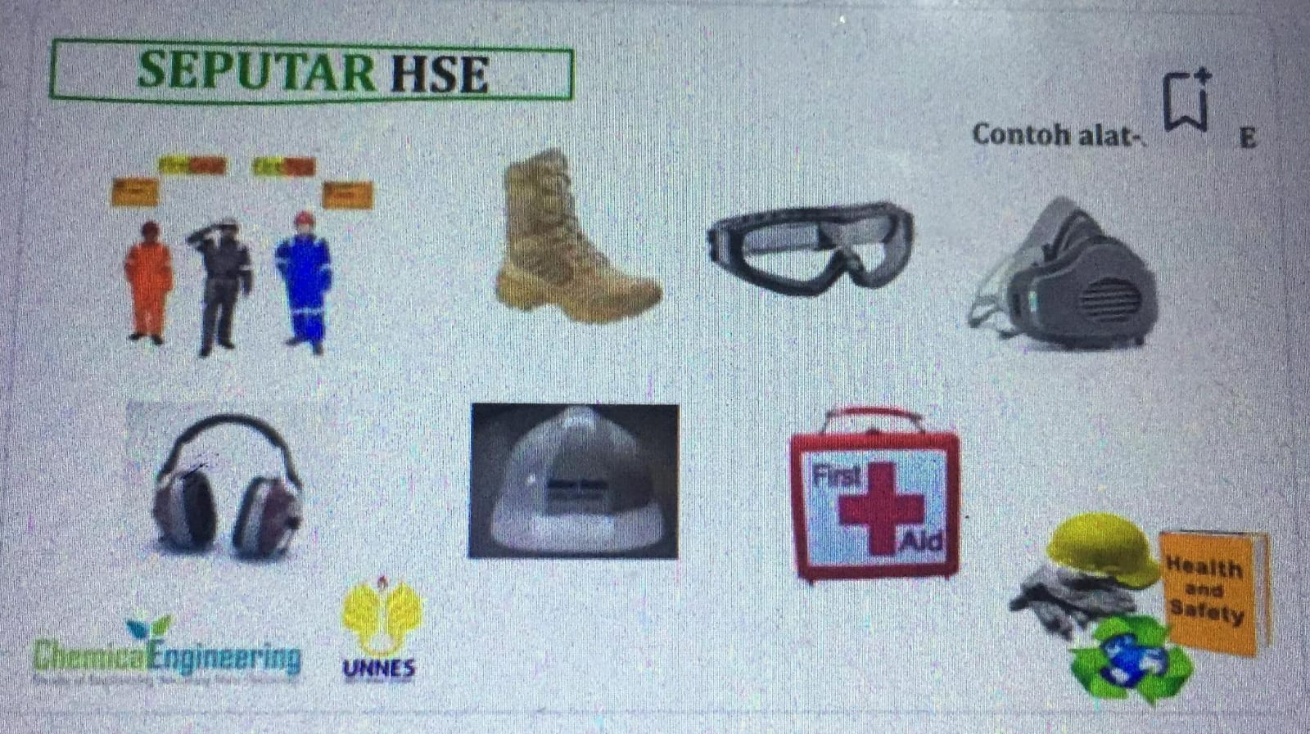

Slide 8
TERIMAKASIH

