Slide 1
PROCEDURAL TEXT
Anita W. KURSASI, S. Pd. M. Pd

Slide 2
What is Procedural Text
A Tipe of text that provides step-by-step instruction on how to complete a task or achieve of goal.
It explains a sequence of actions from the start until finish.

Slide 3
Grammatical Structure used:
Present Tense
Imperative sentence / VERB I as instruction.
Involve a sequence:
- Ordinal Sequence: 1st, 2nd, 3rd, 4th, 5th, 6th, etc…
-First, Next, then, after that, before that, the last, finaly.

Slide 4
HOW TO MAKE INSTANT NOODLE
INGREDIENT: ( MATERIAL)
Instant noodle, 300cc water, 1 egg, Vegetable : Pakcoy, seasoning powder
TOOLS:
Pan, knife, spoon and fork, bowl,

Slide 5
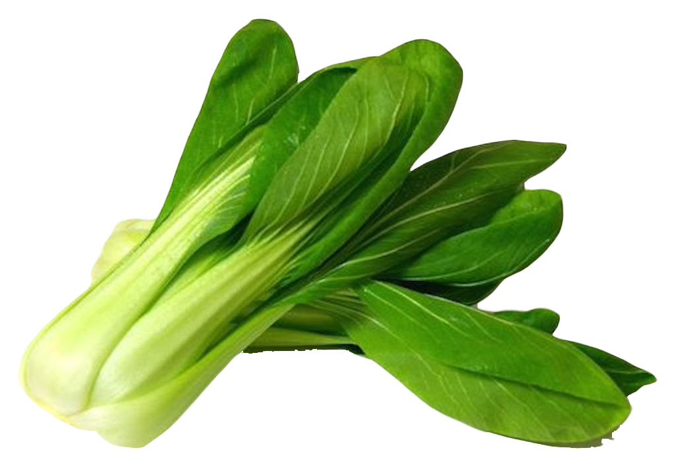
THE STEPS: HOW TO MAKE INSTANT NOODLE?
First, boil 300 cc of water.
Next, put in the instant noodle and stir it well.
After that add the egg, pakcoy and the seasoning. Then, stir it again. wait until done
Finally, place the instant noodle into a bowl.
Instant noodle completed with egg and Pakcoy is ready to served
This Photo by Unknown Author is licensed under CC BY-NC

Slide 6
Active Vs Passive PRESENT: is, are ,am
Argin opens the class doors
The class doors are opened by Argin.
The cats drink the milk up
The milk is drunk by the cats
The noodle is completed with egg and pakcoy
The water is boiled for about 5 minutes
The completed noodle is delicious
the boiled water is still in the pan

Slide 7

Let’s write procedural text together
What kind of procedural text title you have?
How to make a title?
Start the tittle with HOW
Choose an interesting topic
What should be added in Procedural Text?
Pictures
This Photo by Unknown Author is licensed under CC BY-NC-ND

Slide 8

PRACTICE WRITING: How to to send a message?

Slide 9
How to send a message
First, Choose the whats app application
Then, choose the contact name
Next, type the message
Finally, Send it!.

Slide 10
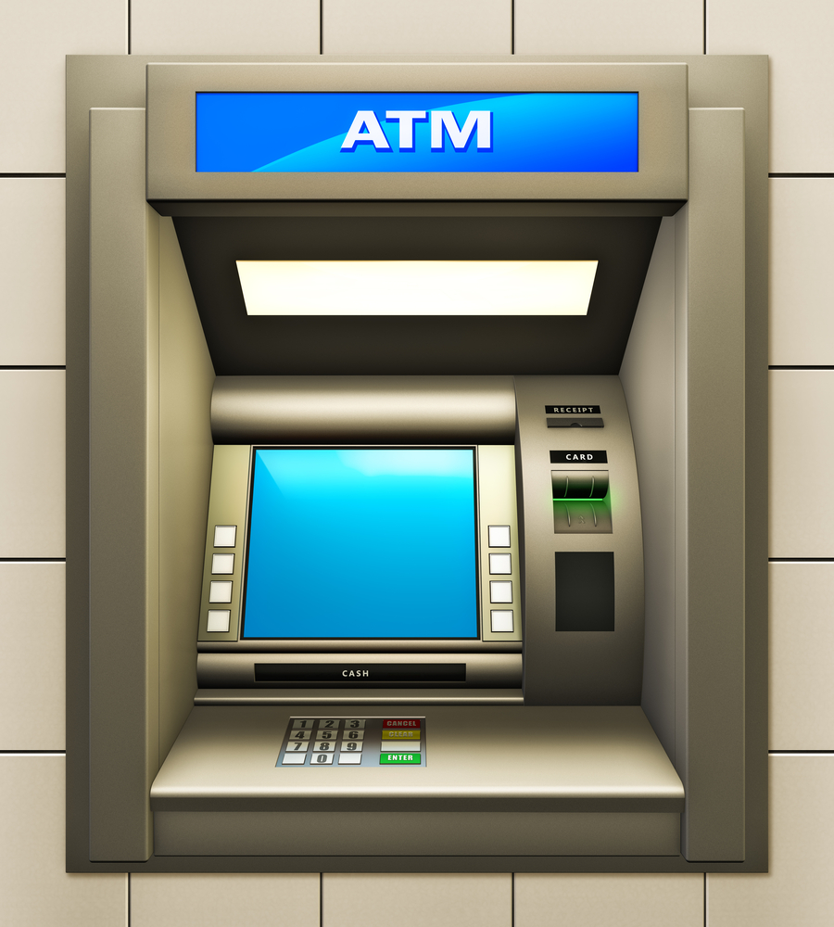
How to withdraw money from Bank Machine?
This Photo by Unknown Author is licensed under CC BY-SA-NC

Slide 11
How to Withdraw Money on Banking Machine?
FIRST, Insert ATM card into the banking machine.
AND select your language.
THEN, enter your password number.
NEXT choose the transaction: withdraw.
AFTER THAT, choose the amount of money.
AND Wait for the money to come out.
FINALLY, take money and card from the banking machine.

Slide 12
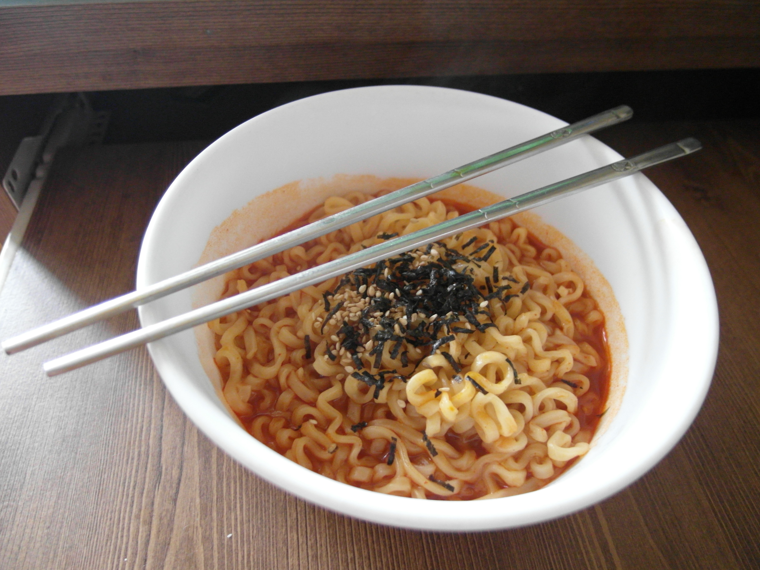
Thank You

Slide 13
TASK 2
Write a procedural text completed with SEQUENCES
Minimum 8 steps.
Present tense ( V1)= IMPERATIVE SENTENCES
FREE TOPIC with the PICTURES
MOODLE and PRINT

