Slide 1
FUTURE TENSE
Anita. W. Kursasi, S.Pd., M. Pd.

Slide 2
FUTURE TENSE
  S + will + Verb 1 + O
S+ be going to + V1 +O
future planning
Intention
Prediction based on present evident
Prediction
Promise
On the spot decision
General thing will happen

Slide 3
WILL: Prediction
The weather report said that there will rain in Malang tomorrow.
If I work hard now, I will become rich in my 30 years old.
There will not be disease in the future.
Nominal : S + Will + be + NAA
I will be a nurse next two years.
I will be in Bima after my graduation
I will be rich

Slide 4
WILL : Promise
If I have money, I will buy you an expensive ring.
I will not tell anyone, You can trust me.
I will reply your letter, soon.
I won’t play games anymore. It really makes me addicted.

Slide 5
WILL : On the spot decission
Wow, the ice cream looks yummy, I ‘ll buy it for us.
The phone is ringing, I will take it first..
Why don’t you eat lunch with me after the class ?. I am still full, I will just accompany you to the canteen

Slide 6
General things will happen
Water will boil at 100 degree celcius.
If the baby get severe dehydration without any hel, she will die ..!.
There will be none alive if the plane fall down to the sea..

Slide 7
S + be ( is am are) going to
Future planning
I am going to wash my motor cycle today
I have proposed her, we are going to marry in December.
Intention
We are going to eat outside tonight.
I am going to apply for the scholarship
Prediction based on present evidence
The sky is cloudy, it is going to rain soon. Let’s hurry up
Oh.. That is our bus, we are going to leave soon..
Watch Out…, that man is drunk, he is going to hit the tree..

Slide 8
Let’s do the exercise
1. We are going to Kuta beach after the seminar. We will swim, sun bath and we ___ (buy) some souvenirs there.
2. I am very tired. I don’t have energy to do anything, so I ________ (sleep) all day long.
3. Turn off the stove soon, You ____ (burn) our house if you always forget to do that.
4. A : Ann is in the hospital.,
B : Really?!. We ____ (visit) her then, won’t we ?.
5. If I have a lot of money, I ____ (buy) you Pajero, you may choose your favorite color.
6. I am a doctor, I ______ (build) my own clinic and dedicate my life for all .
I ____ (lift ) that heavy box for you , Mom.
Next month I _______ (go) back pack around Europe. We will start from Netherland.

Slide 9
Colour scheme
Background
Text &
Lines
Shadows
Title
Text
Fills
Accent
Accent &
Hyperlink
Followed
Hyperlink

Slide 10
Sample Graph (3 colours)

Slide 11
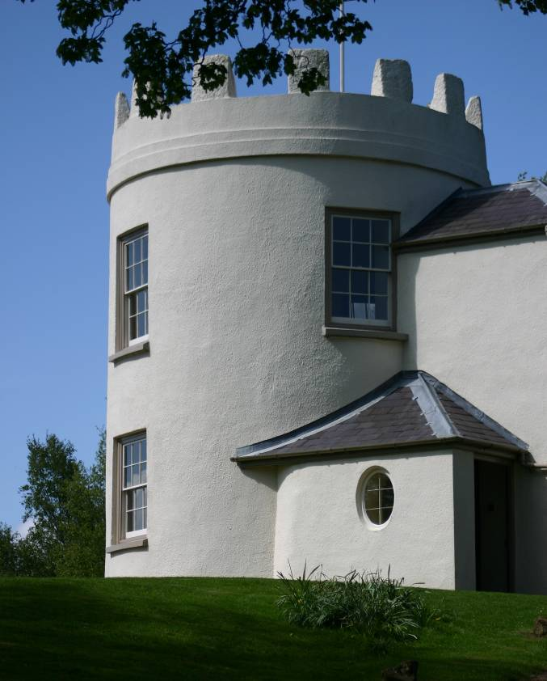
Picture slide
Bullet 1
Bullet 2

Slide 12
Process Flow
Design
Plan
Build
Test
Evaluate
Bullet 1
Bullet 2
Bullet 3
Bullet 1
Bullet 2
Bullet 3
Bullet 1
Bullet 2
Bullet 3
Bullet 1
Bullet 2
Bullet 3
Bullet 1
Bullet 2
Bullet 3

Slide 13
Example of a table
Title | Title
Data | Data
Note: PowerPoint does not allow you to have nice default tables - but you can cut and paste this one

Slide 14
Examples of default styles
Text and lines are like this
Hyperlinks like this
Visited hyperlinks like this
Table
Text box
Text box
With shadow

Slide 15
Use of templates
You are free to use these templates for your personal and business presentations.
We have put a lot of work into developing all these templates and retain the copyright in them. You can use them freely providing that you do not redistribute or sell them.
Do
Use these templates for your presentations
Display your presentation on a web site provided that it is not for the purpose of downloading the template.
If you like these templates, we would always appreciate a link back to our website. Many thanks.
Don’t
Resell or distribute these templates
Put these templates on a website for download. This includes uploading them onto file sharing networks like Slideshare, Myspace, Facebook, bit torrent etc
Pass off any of our created content as your own work
  You can find many more free PowerPoint templates on the Presentation Helper website www.presentationhelper.co.uk

