Slide 1
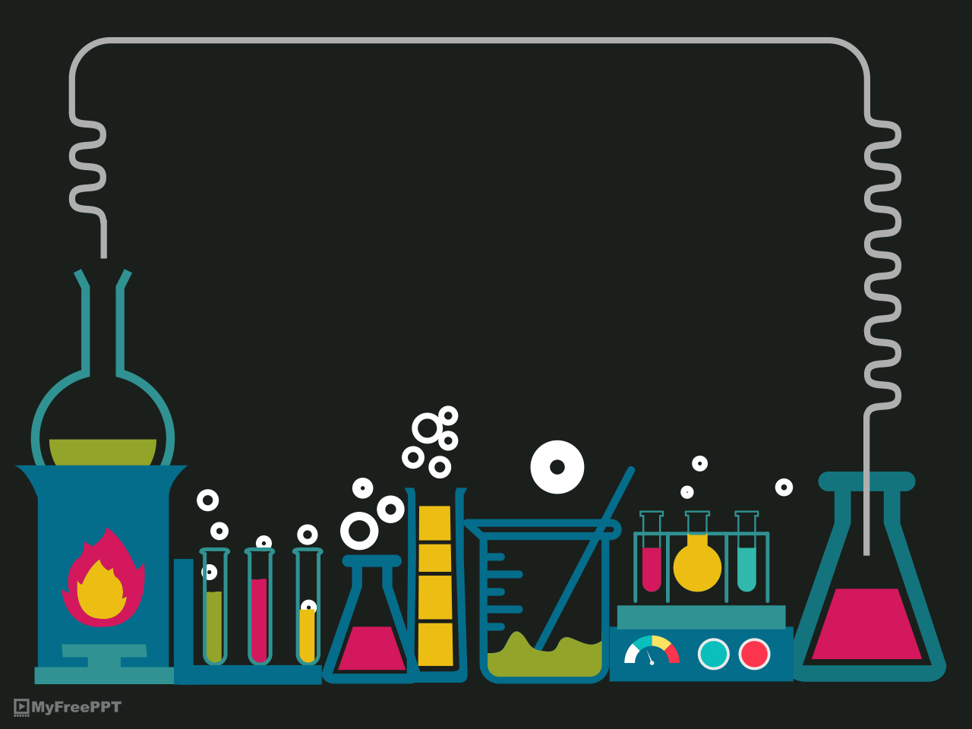
TOXIC AND HAZARD

Slide 2
TOXIC
Toxic is any substance or substance which in a certain amount when it enters the body by being swallowed, inhaled, absorbed, smeared and injected will cause a chemical reaction that causes damage to the structure or function disorders that cause symptoms, illness and death.

Slide 3
TOXIC TYPE:
Based on the source, toxic materials can be classified as follows:
  Plant toxin
  Animal toxin
  Environmental toxins (water, soil, air).
Based on the compound:
  Heavy metal,
  Organic compounds
  Poison gas
3) Based on usage:
  Drugs
  Pesticide
  Organic solvent
  Heavy metal

Slide 4
MAIN ROUTE OF TOXIC
Skin (Absorption)
Breathing (Inhalation)
Digestion

Slide 5
TOXIC EFFECT
Adverse Effect
Toxic Effect on Biological System
Local Effect
Systemic Effect

Slide 6
TOXIC COUNTERMEASURES
  Wash vegetables and fruits thoroughly before processing or eating
  Using clean (unpolluted) water to handle and process food
  Do not use cooking utensils or containers that are coated with heavy metal
  Do not use styrofoam containers or crackle plastic to accommodate hot and fatty ready-to-eat food because there is a chance of transfer of chemical compounds from the container to the food
  Use personal protective equipment

Slide 7
HAZARD
Hazards are sources, situations, actions and components that have the potential to cause harm and are considered to cause damage or disruption of processes/activities therein to work accidents.

Slide 8
SOURCE OF DANGER
In the work process there are sources of danger, namely
  Human
  Equipment
  Material
  Process Production
  System and Procedure
  Unsafe Action
  Unsafe Condition

Slide 9
HAZARD CONTROL
Elimination
Substitution
Engineering
Administrative
Personal Protective Equipment

