Slide 1
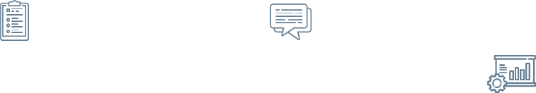

KALA II
PERSALINAN

Slide 2
01
02
Membantu kelahiran bahu
Manuver tangan dan langkah-langkah dalam pertolongan persalinan
04
Kebutuhan spiiritual yang dibutuhkan
03
Penanganan bayi baru lahir normal (IMD)
05
Prinsip budaya yang bermanfaat untuk proses persalinan

Slide 3
Manuver tangan dan langkah-langkah dalam pertolongan persalinan

Slide 4
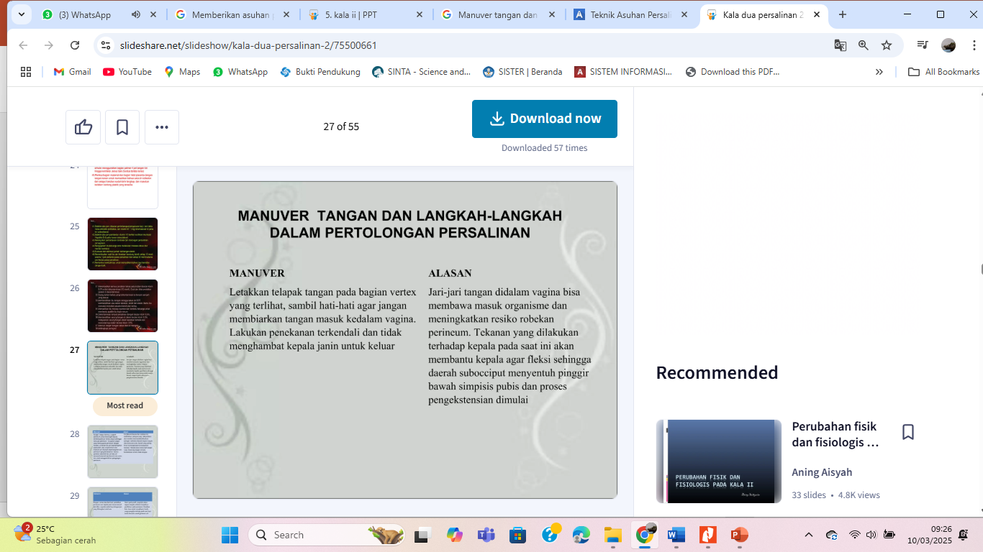
—SOMEONE FAMOUS
“This is a quote. Words full of wisdom that someone important said and can make the reader get inspired.”

Slide 5
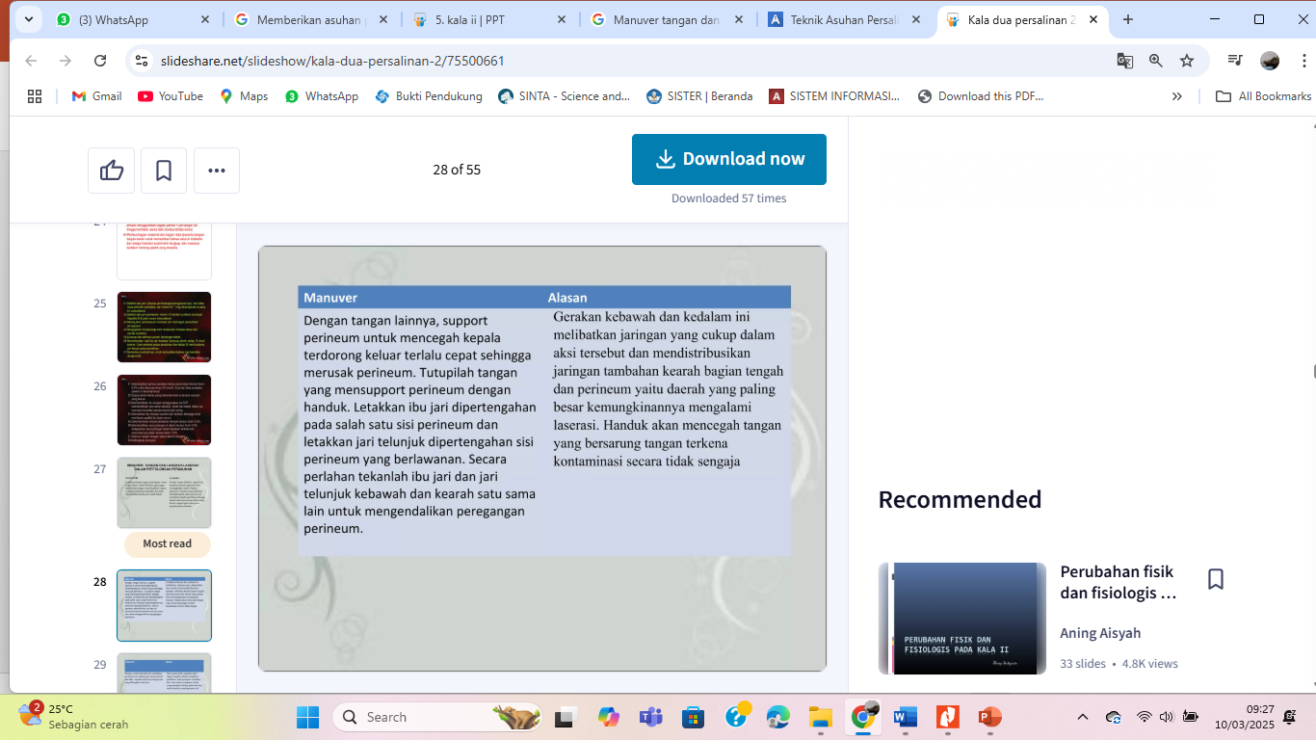
01.
THIS IS A GREAT HEADLINE
And this is the subtitle that makes it comprehensible

Slide 6
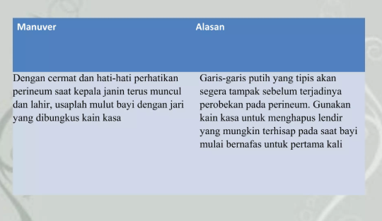
THE SLIDE TITLE GOES HERE!
Do you know what helps you make your point clear?
Lists like this one:
Because they’re simple
You can organize your ideas clearly
And because you’ll never forget to buy milk!
And the most important thing: the audience won’t miss the point of your presentation

Slide 7
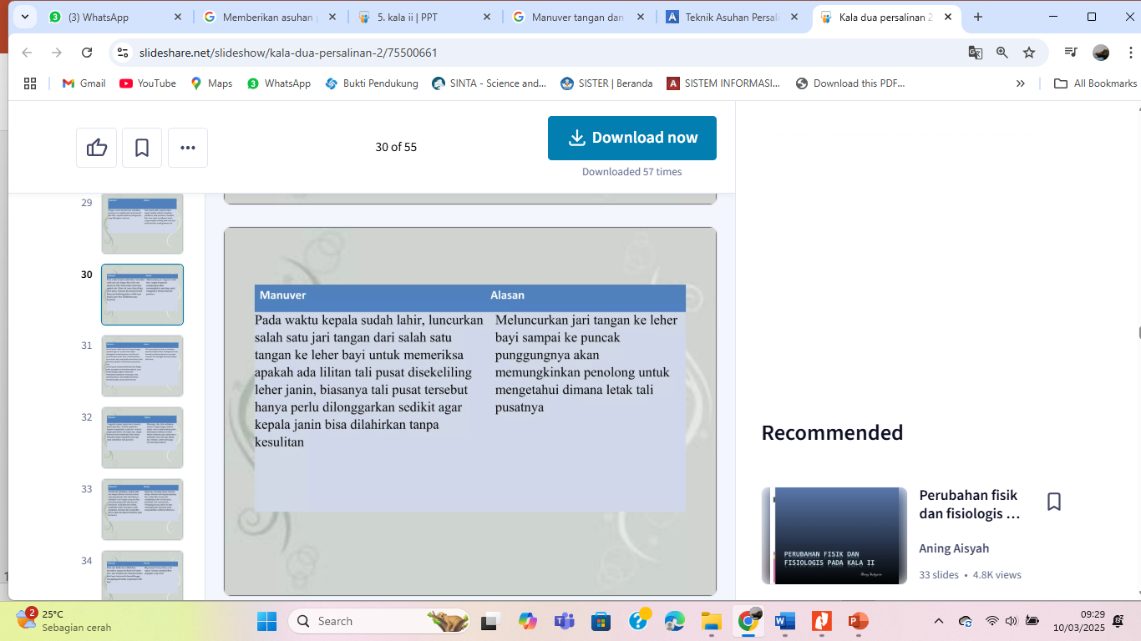
MAYBE YOU NEED TO DIVIDE THE CONTENT
MERCURY
VENUS
Mercury is the closest planet to the Sun and the smallest one in the Solar System—it’s only a bit larger than our Moon. The planet’s name has nothing to do with the liquid metal, since it was named after the Roman messenger god, Mercury
Venus has a beautiful name and is the second planet from the Sun. It’s terribly hot—even hotter than Mercury—and its atmosphere is extremely poisonous. It’s the second-brightest natural object in the night sky after the Moon

Slide 8
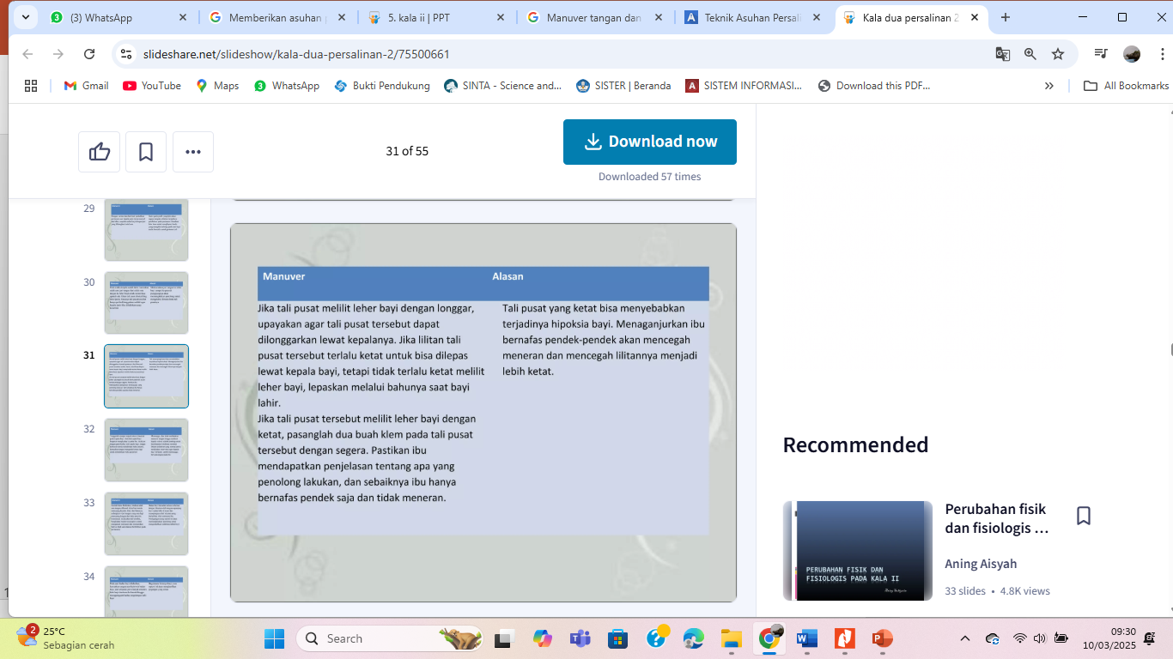
YOU COULD USE THREE COLUMNS, WHY NOT?
MARS
JUPITER
MERCURY
Despite being red, Mars is a cold place, not hot. It’s full of iron oxide dust, which gives the planet its reddish cast
It’s a gas giant and also the biggest planet in our Solar System. Jupiter is the fourth-brightest object in the sky
Mercury is the closest planet to the Sun and the smallest one in the Solar System—it’s only a bit larger than our Moon

Slide 9
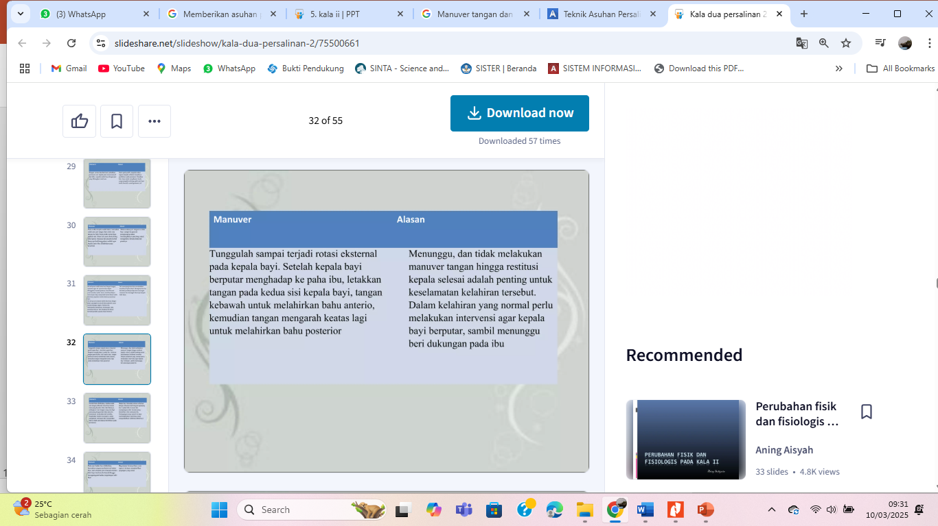
A PICTURE ALWAYS REINFORCES THE CONCEPT
Images reveal large amounts of data, so remember: use an image instead of long texts. Your audience will appreciate that

Slide 10
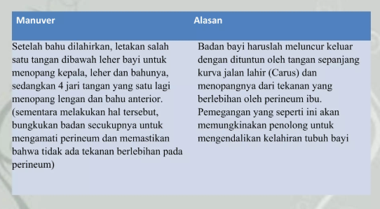
A PICTURE IS WORTH A THOUSAND WORDS

Slide 11
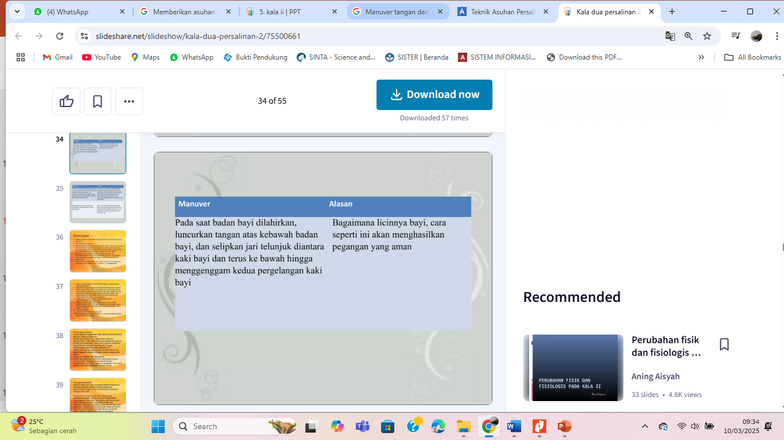
AWESOME WORDS
Key words are great for catching your audience’s attention

Slide 12
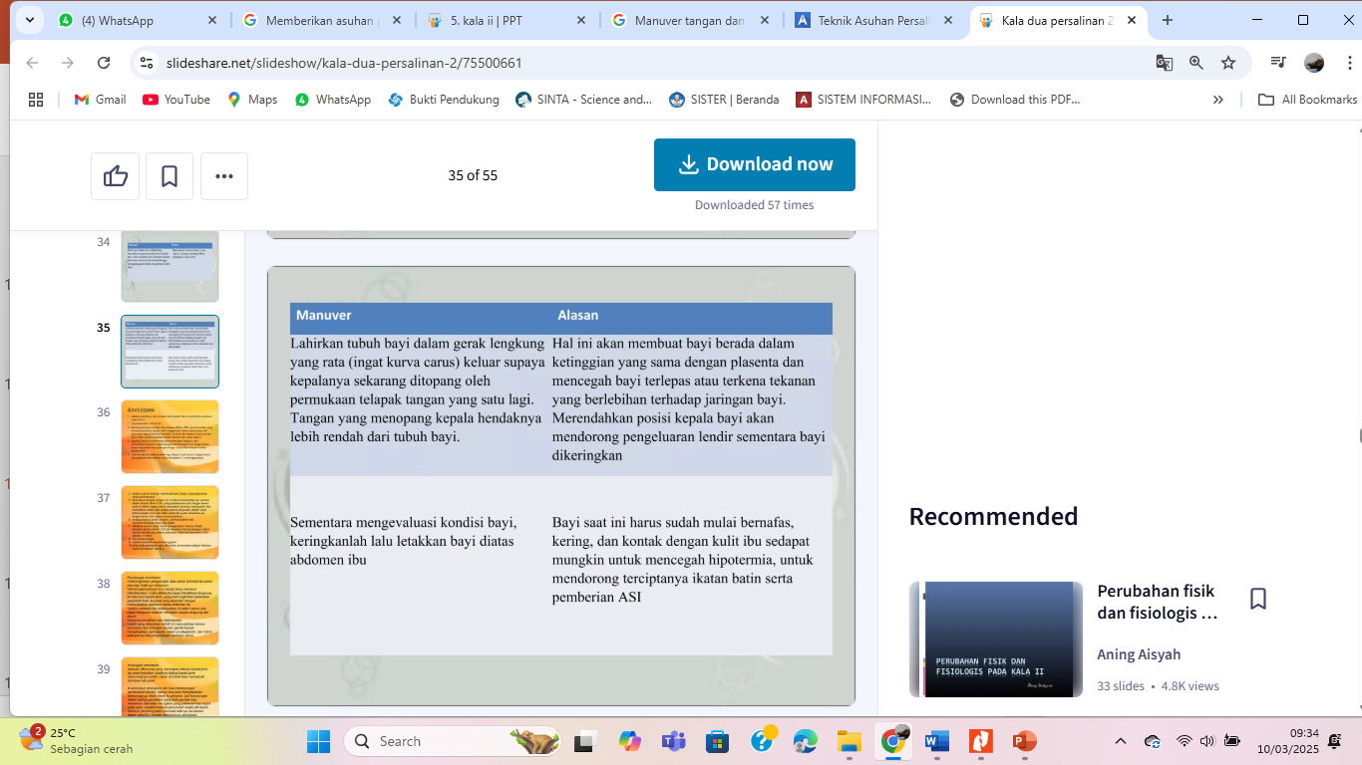
.02
SECTION TITLE
And this is the subtitle that makes it comprehensible

Slide 13
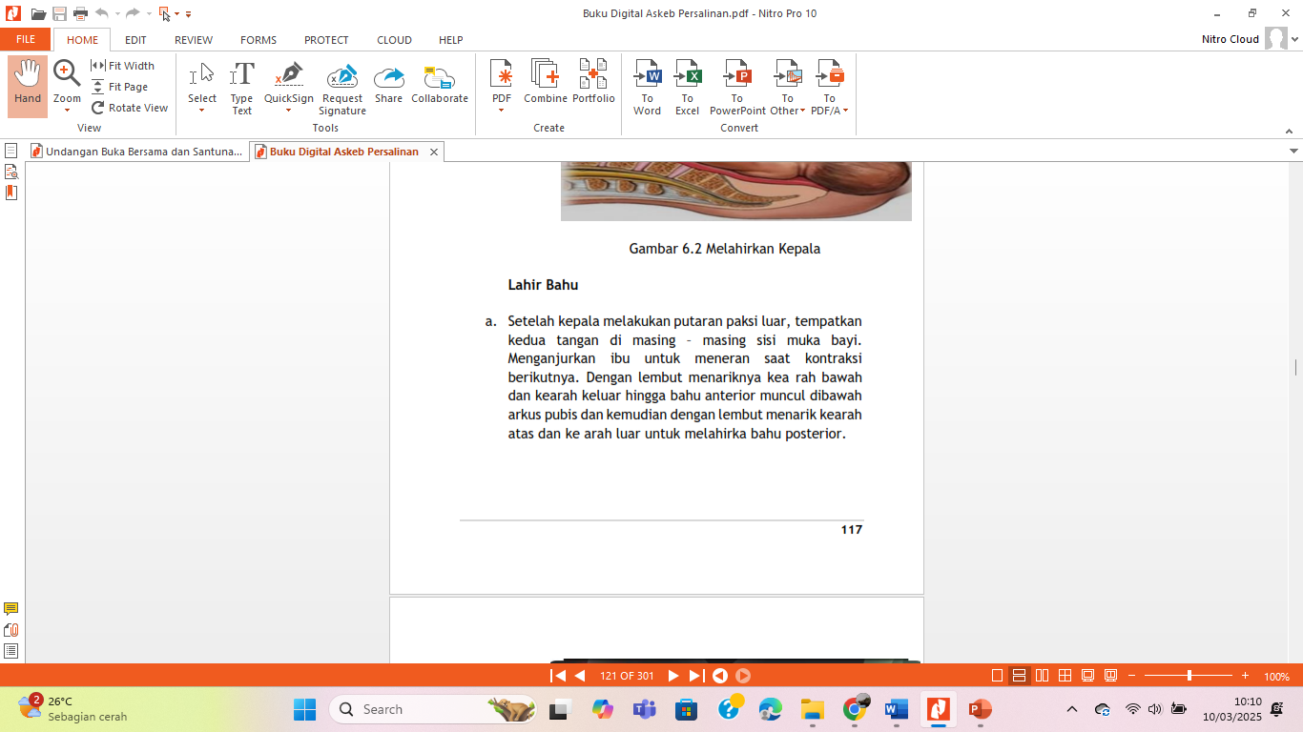
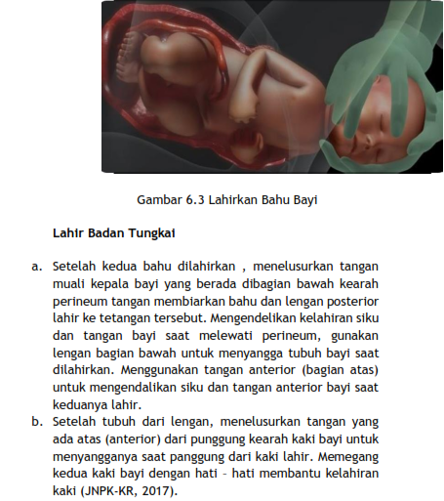
REINFORCE THE CONCEPT USING INFOGRAPHICS!
Despite being red, Mars is a cold place, not hot. It’s full of iron oxide dust
Venus has a beautiful name, but it’s terribly hot, even hotter than Mercury
Mercury is the closest planet to the Sun and is only a bit larger than our Moon

Slide 14
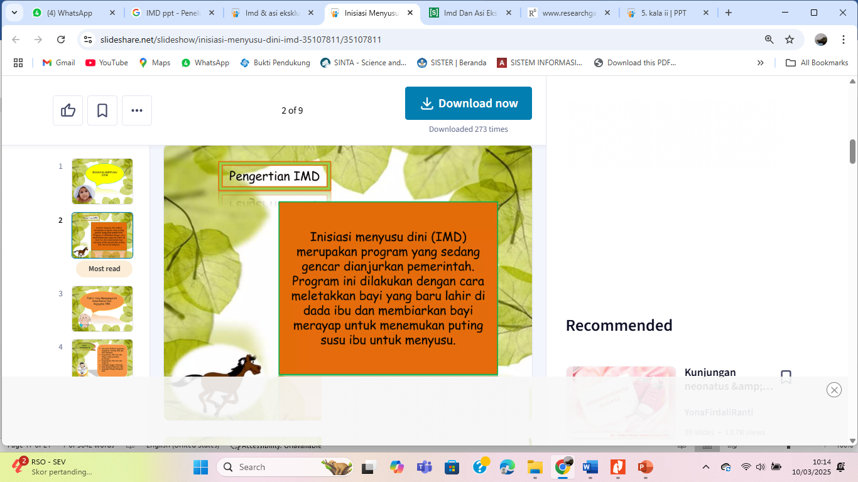
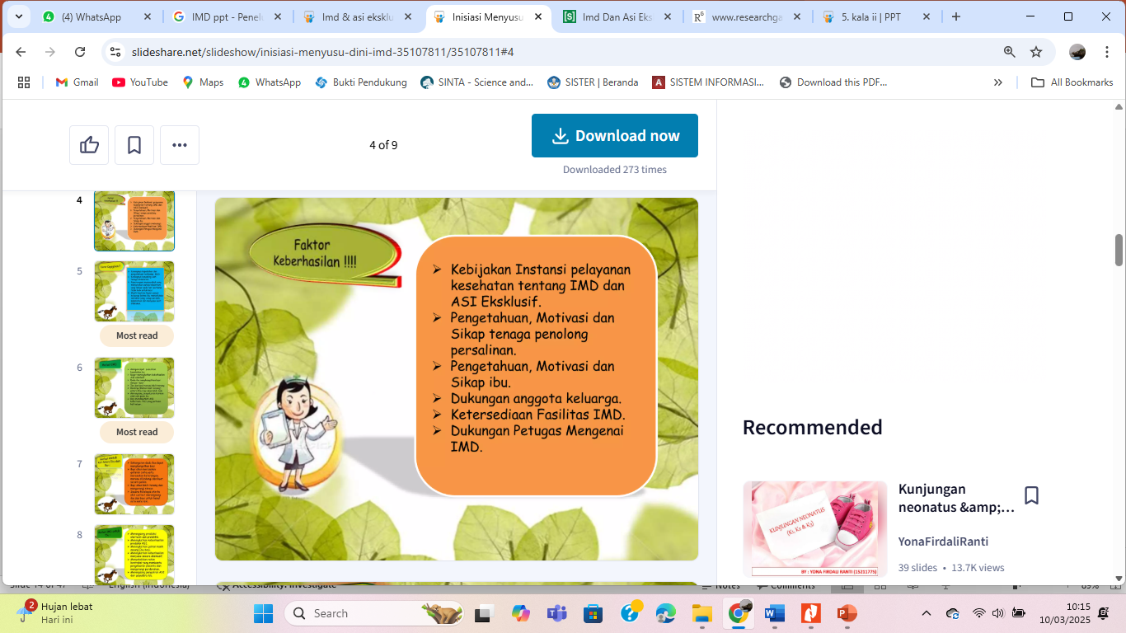

IF YOU WANT TO MODIFY THIS GRAPH, CLICK ON IT, FOLLOW THE LINK, CHANGE THE DATA AND REPLACE IT
MARS
MERCURY
Despite being red, Mars is a cold place, not hot
Mercury is the closest planet to the Sun
VENUS
NEPTUNE
Venus has a beautiful name, but it’s terribly hot
Neptune is the farthest planet from the Sun

Slide 15
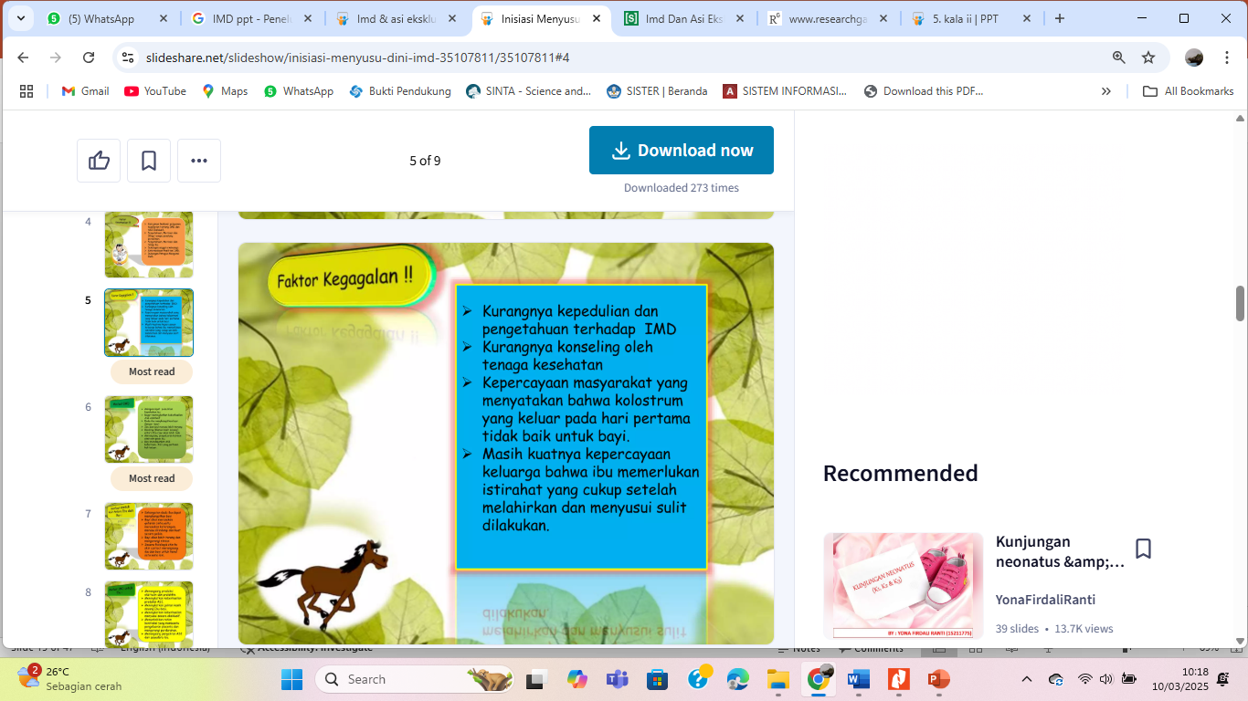
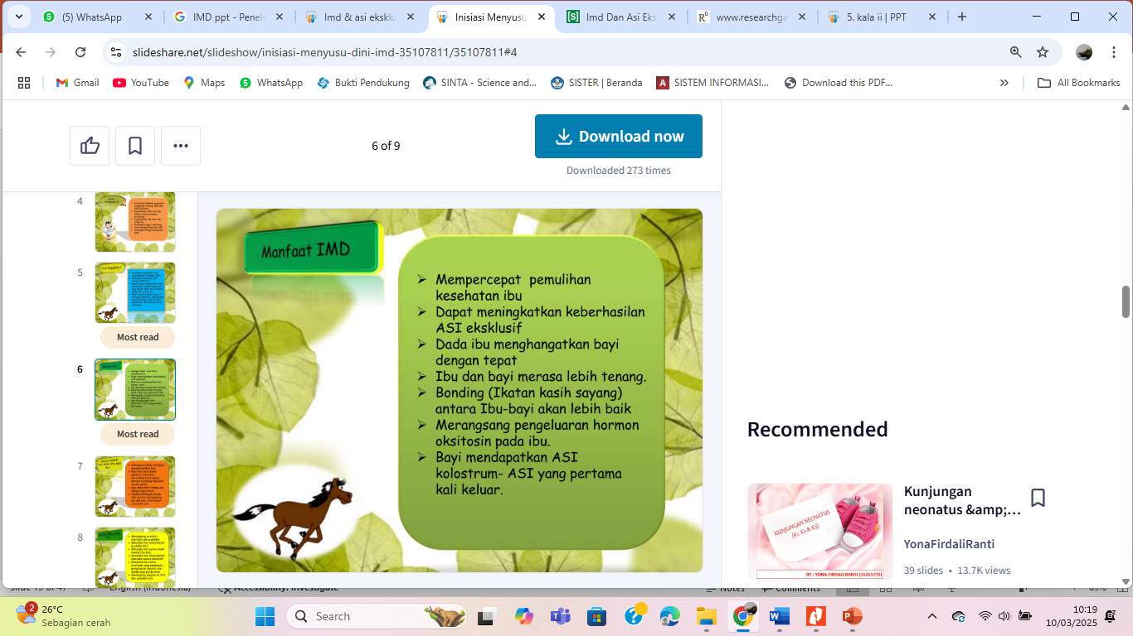
INFOGRAPHICS MAKE YOUR IDEA UNDERSTANDABLE…
Saturn is the ringed one. It’s composed mostly of hydrogen and helium
Neptune is the farthest planet from the Sun and the fourth-largest by diameter
Venus has a beautiful name and is the second planet from the Sun. It’s very hot
Mercury is the closest planet to the Sun and the smallest one in our Solar System

Slide 16
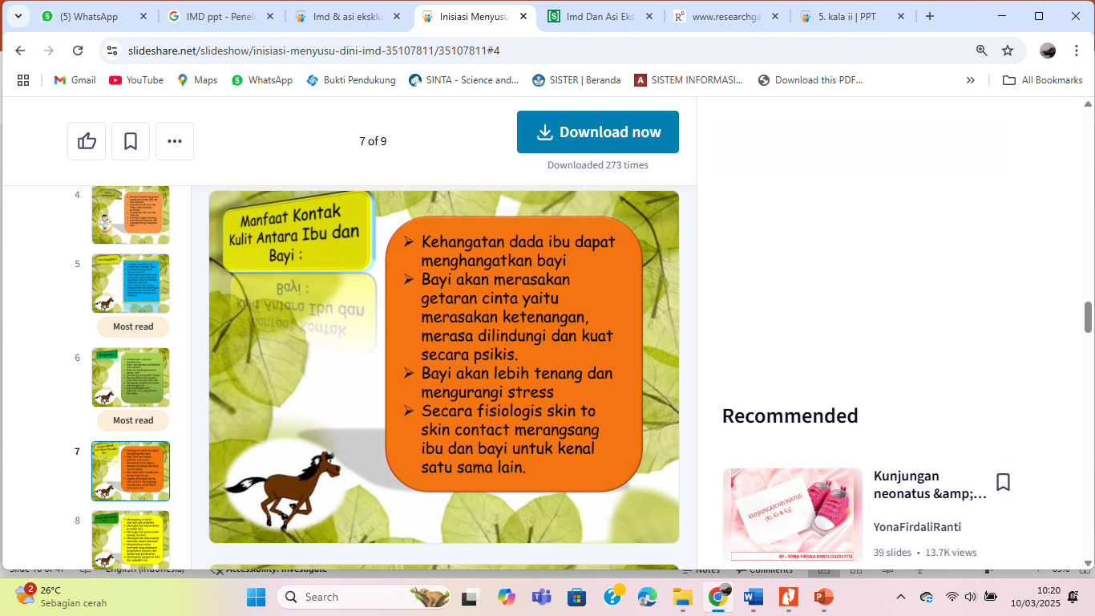
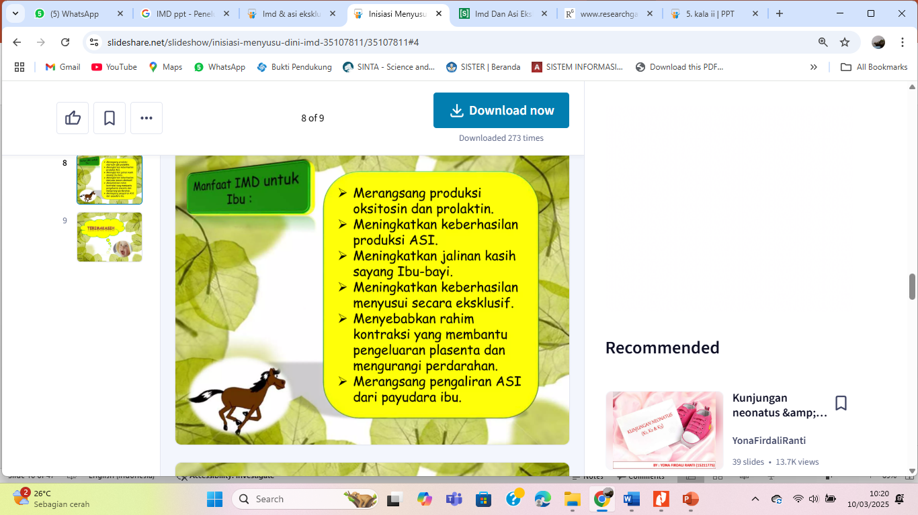
… AND THE SAME GOES FOR TABLES
 | MASS (earths) | DIAMETER (earths) | SURFACE GRAVITY (earths)
MERCURY | 0,06 | 0,38 | 0,38
MARS | 0,11 | 0,53 | 0,38
SATURN | 95,2 | 9,4 | 1,16

Slide 17
Kebutuhan Spiritual
Prinsip Budaya dalam Persalinan

Slide 18
THANKS!
Does anyone have any questions?
addyouremail@freepik.com
+91 620 421 838
yourcompany.com

