Slide 1


PART OF SPEECH
By
Anita Wahyuning Kursasi, S.Pd, M.Pd

Slide 2


VERB
ADJECTIVE
PART OF SPEECH
ADVERB
NOUN

Slide 3

VERB = KATA KERJA
Verb adalah kata kerja, baik dalam bentuk aktif maupun Pasif. ( dari Verb1 – Verb ING )
Verb terdiri dari Regular n Irregular Verb
Verb biasanya berfungsi sebagai predikat.
Beberapa Verb mempunyai bentuk yang sama dengan adjective –nya
Contoh : Mrs. Anita closed the class
The library is closed to my home
When I was kid, I interested in Puzzle.
Puzzle is interesting

Slide 4


Find the VERB of this passage
My interest is banking. I dont really know when It made me interested. Whatever you say, for me Banking is very interesting. By working in a Bank I can get many information about how the development of economy in the world, at least in our own country. So, I can predict almost exactly what will happen in my business related with the money currency and so on.

Slide 5
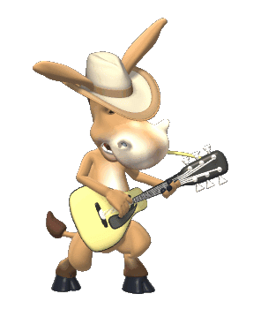
ADJECTIVE
Adjective = Kata Sifat
Adjective terdiri dari Pure Adjective dan Formed Adjective yang terbentuk dari Kata Kerja
PURE ADJECTIVE | FORMED ADJECTIVE
Happy >< sad | satisfied
Young >< old | Bored
Short >< tall | interested

Slide 6
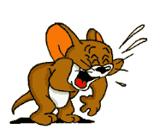
Contoh Penggunaan Adjective
He always calms me down. I am calm.
He scares me, I am very scared
The new restaurant satisfies all customers.
The customers are satisfied
I feel cold = I am cold
I felt sad = I was sad
I will feel happy = I will be happy

Slide 7
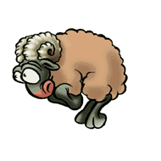
ADVERB
Adverb = Kata Keterangan
Adverb dibagi 3 :
Adverb of time
Mrs. Anita works in Languange laboratory everyday, she was there yesterday too.
2. Adverb of manner
I stay in Jl. Borobudur Indah 7 Malang
We will wait for you in Ria Jenaka restaurant
3. Adverb of Manner = mmenjelaskan tentang cara suatu kegiatan dilakukan
Rizky Esa speaks English fluently.
Robbi maika treated his girl nicely
Maria dances beautifully

Slide 8
NOUN
NOUN = Kata Benda
Kata Benda dibagi 2 : Kata Benda Nyata dan Kata Benda abstrak
Kata Benda Nyata | Kata Benda Abstrak
Leader = pemimpin Organisator = Orang yang suka berorganisasi Creator = pencipta | Leadership = Kepemimpinan Organization = Organisasi Creation = kreasi Creativity = kreatifitas
Soekarno was a good leader Ana Nurmayanti is an organisator. | His leadership was great She leads Students Organization of Stikes WG

Slide 9
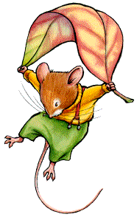
EXERCISE
ANALYZE THE PART OF SPEECH BELOW
Alysha is beautiful, She always beautifies herself.
Her beauty makes her very popular in our campuss
2. Mrs. Anita gave clear instruction. She Instructed us to make Film analysis last two weeks
3. God is our creator. He creates all of the things in the universe. We are HIS creators. So, we must be creative, to be able to create everything creatively.
4. Ir. Soekarno was the leader in ‘40-’70s. He lead Indonesia to indepenence. His leadership was great

Slide 10
Verb Vs Adjective Vs Adverb Vs Noun
All food interest me
My interest is cooking
I am very interested to cook and create my own recipe.
In my opinion, cullinary world is interesting
Mr. Brown is a carefull midwife.
She helps the patients carefully.
The patient needs immediate surgery
We sent to the hospital immediately.

Slide 11
Fill the blank with adj or adverb
1. Dhani is an (active)...............organisator in campuss
She ................join BEM and Englih Club.
2. Mrs. Hani must (regular) .................visit the midwife.
She needs........................... Examination every month.
3. Mrs. Anita (hardly) ..................... Met Winda Melissa.
She must study ........... to improve her English better.
4. Line and Instagram are a (recent)............inovation in Social Media. I have used them ........................

Slide 12
Fill the blank with Noun or Verb
1. Thomas Alfa Edison (invent) ............. The light bulb. He was a very great ............... in his era.
2. Raditya Dika (satisfy) ............ His fans by releasing the newest film, ‘ Single’. He is really an artist who is able to give ........... For his fans
3. My friends (colllect)................a hundreds of novels. Most of her ............... are romance.
4. Rina Gunawan often (organize) ............. the celebrities’ wedding party. She is really a wellknown event .............................

Slide 13

Thank you
See U !!
...

