Slide 1



5th Meeting
BAHASA INGGRIS KEPERAWATAN

Slide 2

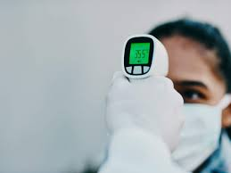
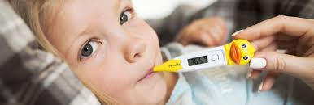
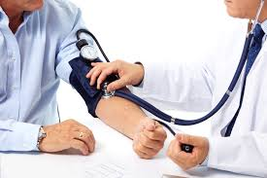
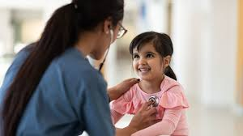
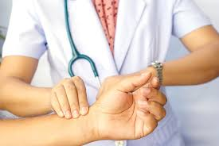
What procedure is it?
Today’s Topic
Body Temperature
Blood Pressure
Heart Rate
Pulse Rate

Slide 3
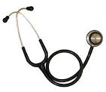
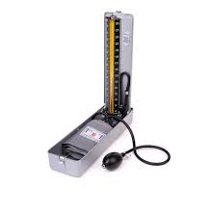
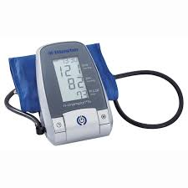
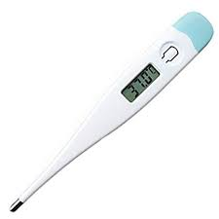
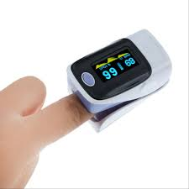
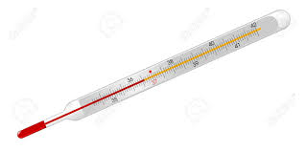

Slide 4

Checking Vital Sign
Objectives
By the end of the meeting, the students are able to:
use vital sign checking- related vocabulary items correctly.
pronounce the related vocabulary items accurately.
produce sentences (conversation exchange) using correct imperative sentences and expression in checking patients’ vital sign.

Slide 5
Vocabulary in Focus
Let’s check it out
MODULE Page 16

Slide 6
Review
What is procedural text?
A piece of text that gives us instructions for doing something.

Slide 7
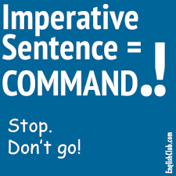
We will use imperative sentences a lot when we give instruction to the patient during vital sign checking.

Slide 8
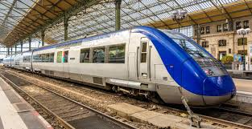
Imperatives
An imperative sentence gives an order, command, advice or request. It tells someone to do something.
1.
A. John is going to miss the train.
B. John, hurry up otherwise you will miss the train.

Slide 9
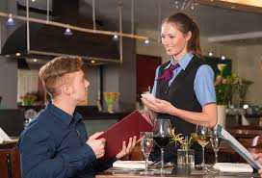
Imperatives
2.
A. Please bring me a glass of water.
B. Do you want a glass of water?

Slide 10

Imperatives
3.
A. She is putting her book in the bag.
B. Put your book in the bag, please.

Slide 11
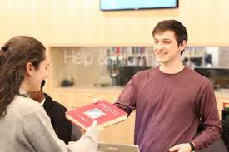
Imperatives
4.
A. Lend me your book, please.
B. He is ready to give me his book.

Slide 12
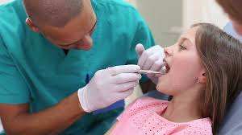
Imperatives
5.
A. Open your mouth, please.
B. She opens her mouth.

Slide 13
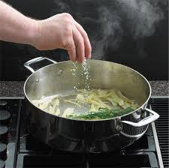
Imperatives
6.
A. You need to add a pinch of salt.
B. Add a pinch of salt to the soup.

Slide 14
Example of Imperative Sentences
1.
Raise your arm
5.
Unbotton your shirt
2.
Roll your sleeve up
6.
Breath in
3.
Take a deep breath
7.
Lie flat on the bed
4.
Give me your right hand

Slide 15
Imperative sentences
You take a deep breath. (No)
Don’t touch it. (Yes)
Turn off the ringtones. (Yes)
You roll your sleeves up. (No)
Come here, please. (Yes)
Raise your right arm. (Yes)
You will come here later. (No)

Slide 16
Useful Expression
Let’s take a look at..
MODULE Page 17

Slide 17

Thank you

