Slide 1

GANGGUAN SISTEM MUSKULOSKELETAL
Abdul Qodir

Slide 2
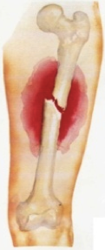
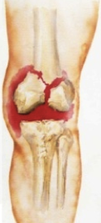
Definisi Fraktur Tulang
Terjadinya diskontinuitas (Ketidak Sinambungan) jaringan tulang / tulang rawan.
    Penyebab: Trauma
    Berat
    Ringan

Slide 3
Klasifikasi
Fraktur diklasifikasikan berdasarkan:
  Type
  Communication or noncommunication with external environment
  Anatomic location

Slide 4
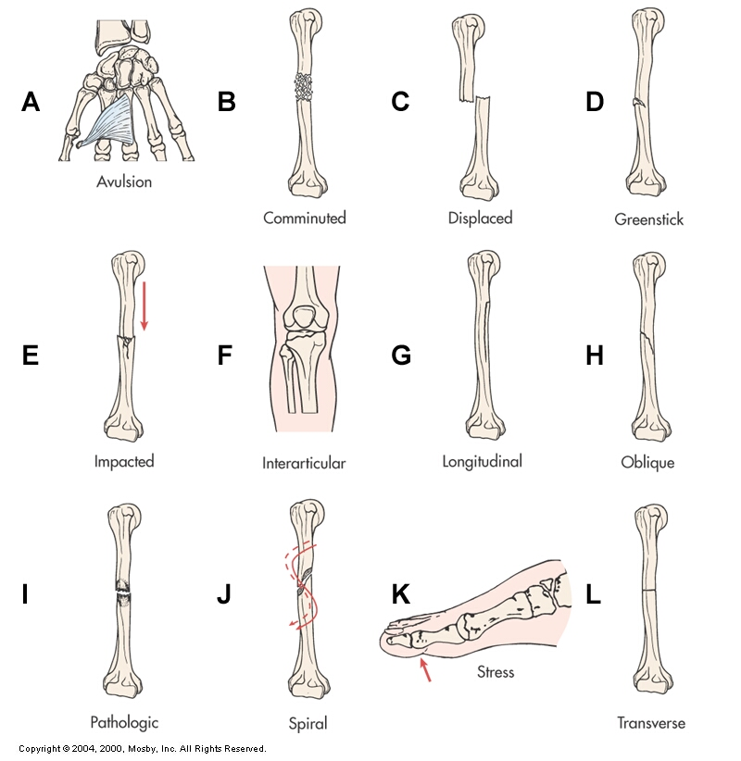
Types of Fractures
Fig. 61-4

Slide 5
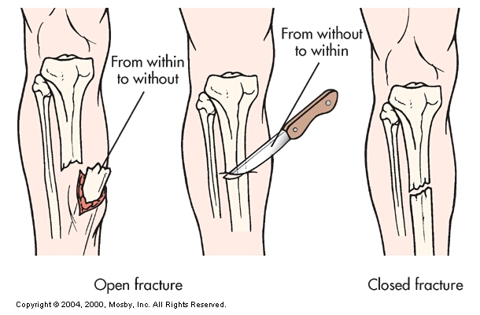
Classification by Communication with
External Environment
Fig. 61-5

Slide 6
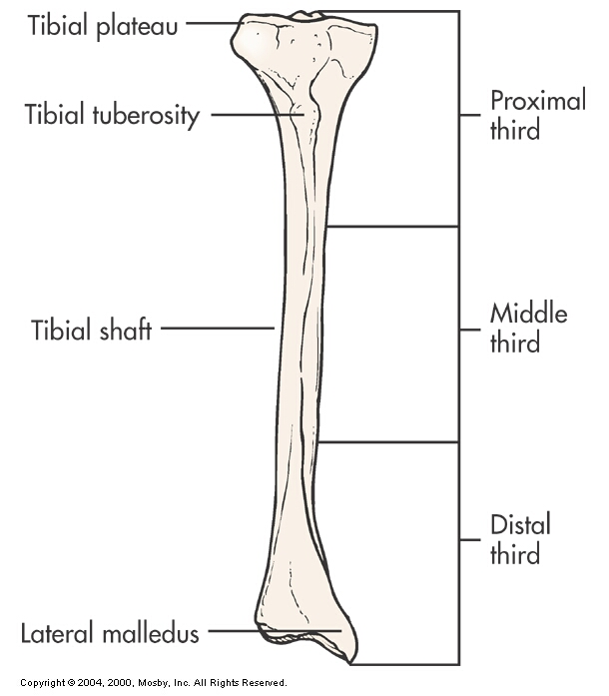
Classification by Fracture Location
Fig. 61-6

Slide 7
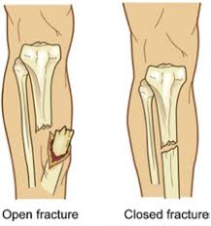
Klasifikasi
Communication or noncommunication with external environment
Fraktur tertutup
Braktur terbuka

Slide 8
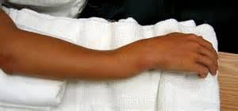
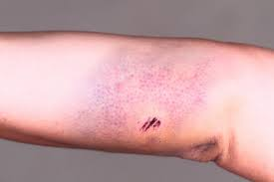
Manifestasi klinis
Pergerakan abnormal
Crepitus
Deformity
Tenderness
Pain
Gangguang fungsi
Bengkak

Slide 9
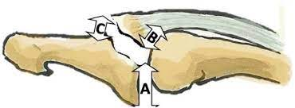
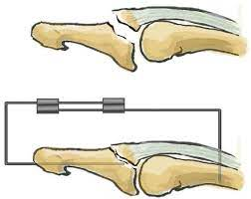
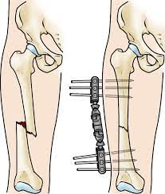
Collaborative Care
Overall goals of treatment:
  Penataan kembali anatomi fragmen tulang (reduction)
  Imobilisasi untuk mempertahankan kesejajaran (fixation)
  Pemulihan fungsi normal

Slide 10
Collaborative Care
Penataan kembali anatomi fragmen tulang (reduction)
Closed reduction
  Nonsurgical, Penataan kembali secara manual
Open reduction
  Koreksi kesejajaran tulang melalui bedah

Slide 11
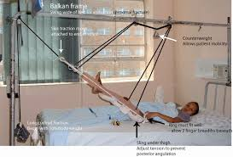
Collaborative Care
Fracture Reduction
Traction (with simultaneous counter-traction)
  Penerapan gaya tarik untuk mencapai penataan kembali
    Skin traction (short-term: 48-72 hrs)
    Skeletal traction (longer periods)

Slide 12
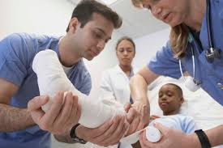
Collaborative Care
Fracture Immobilization
Casts (Gips)
  Biasanya digunakan setelah reduksi tertutup

Slide 13
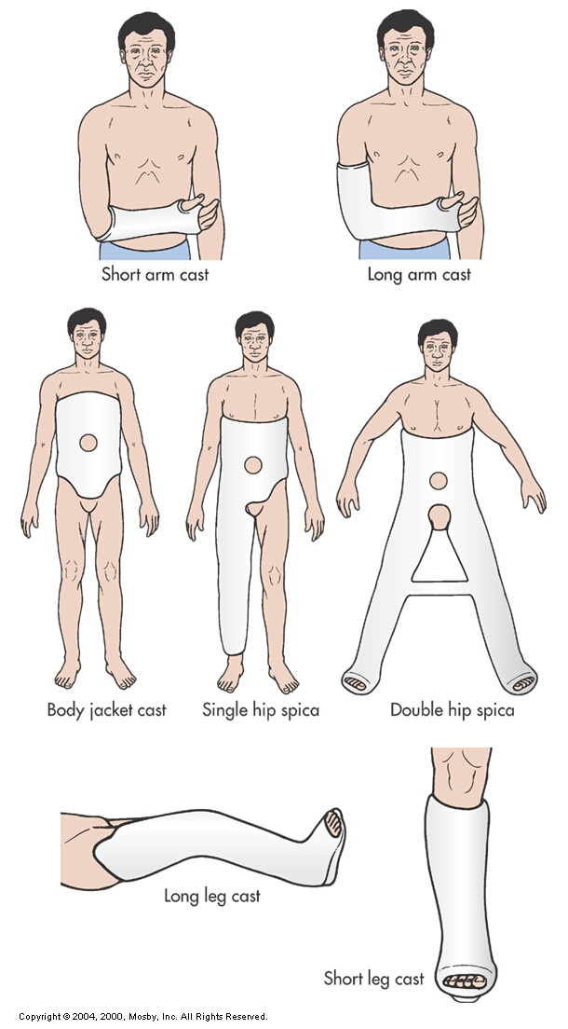
Casts
Fig. 61-9

Slide 14
Collaborative Care
Fracture Immobilization
Purpose of traction:
  Mencegah dan mengurangi spasme otot
  imobilisasi
  Reduction
  Treatment kondisi patologis

Slide 15
Nursing Management
Nursing Assessment for Fractures
Riwayat singkat trauma/kecelakaan
Mekanisme injury
Pengkajian khusus difokuskan pada daerah distal di lokasi cedera

Slide 16
Nursing Management
Nursing Assessment
Neurovascular assessment
  warna and temperature
    cyanotic and cool/cold: arterial insufficiency
    Biru dan hangat: venous insufficiency
  Capillary refill (want < 3 sec)
  Peripheral pulses (↓ indicates vascular insufficiency)

Slide 17
Nursing Management
Nursing Assessment
Neurovascular assessment
  Edema
  Sensation (sensorik)
  Motor function (motrik)
  Pain

Slide 18
Nursing Management
Nursing Diagnoses
Risiko Neurovakuler perifer tidak efektif
Nyeri akut
Risiko infeksi
Gangguan intergritas kulit/jaringan
Risiko gangguan intergritas kulit/jaringan
Gangguan mobilitas fisik

Slide 19
Nursing Management
Nursing Implementation
General post-op care
  Assess dressings/casts for bleeding/drainage
  Prevent complications of immobility
    Cegah konstipasi
    Sering mengubah posisi
    ROM exercised pada sendi yang tidak fraktur
    Napas dalam

Slide 20
Nursing Management
Nursing Implementation: Cast care
Casts can cause neurovascular complications if
  Too tight (terlalu ketat)
  Edematous
Frequent neurovascular checks
Ice and elevation during early phase

Slide 21
Complications of Fractures
Infection
Open fractures and soft tissue injuries have ↑ incidence
Osteomyelitis can become chronic

Slide 22
Complications of Fractures
Infection
Collaborative Care
  Open fractures require aggressive surgical debridement
  Post-op IV antibiotics for 3 to 7 days (prophylactic)

Slide 23
Complications of Fractures
Compartment Syndrome
Kondisi di mana peningkatan tekanan intrakomparmental dalam kompartemen myofascial yang terbatas membahayakan fungsi neurovaskular jaringan di dalam ruang tersebut.
Penurunan perfusi

Slide 24
Complications of Fractures
Compartment Syndrome
Two basic etiologies create compartment syndrome:
  Penurunan ukuran compartment (dressings, splints, casts)
  Peningkatan isi compartment (bleeding, edema)

Slide 25
Complications of Fractures
Compartment Syndrome
Clinical Manifestations
  Six Ps
    Paresthesia (sensasi seperti tertusuk jarum atau mati rasa pada bagian tubuh tertentu)
    Pain
    Pressure
    Pallor (loss of normal color, coolness)
    Paralysis (lumpuh karena gangguan pada saraf yang berperan dalam mengatur gerakan otot tubuh)
    Pulselessness (decreased/absent pulses)
    Patient may present with one or all of the six Ps and Compare extemities

Slide 26
Complications of Fractures
Compartment Syndrome
Clinical Manifestations
  Absence of peripheral pulse = ominous late sign
  Myoglobinuria
    Dark reddish-brown urine

Slide 27
Terima Kasih

