Slide 1
DIAGNOSTIC NEUROLOGY
The Nursing Role in Neuroradiology

Slide 2
What is a neurological examination?
Assesses motor and sensory skills, the functioning of one or more cranial nerves, hearing and speech, vision, coordination and balance, mental status, and changes in mood or behavior, among other abilities. Items including a tuning fork, flashlight, reflex hammer, ophthalmoscope, and needles are used to help diagnose brain tumors, infections such as encephalitis and meningitis, and diseases such as Parkinson’s disease, Huntington’s disease, amyotrophic lateral sclerosis (ALS), and epilepsy. Some tests require the services of a specialist to perform and analyze results.
Notes:
Menilai keterampilan motorik dan sensorik, fungsi satu atau lebih saraf kranial, pendengaran dan pidato, visi, koordinasi dan keseimbangan, status mental, dan perubahan mood atau perilaku, antara kemampuan lain. Item termasuk garpu tala, senter, palu refleks, ophthalmoscope, dan jarum yang digunakan untuk membantu mendiagnosa tumor otak, infeksi seperti ensefalitis dan meningitis, dan penyakit seperti penyakit Parkinson, penyakit Huntington, amyotrophic lateral sclerosis (ALS), dan epilepsi. Beberapa tes membutuhkan jasa seorang spesialis untuk melakukan dan menganalisis hasil.

Slide 3
The Nursing Role in Radiology
Neurology
Radiology
Nurse

Slide 4
Nervous System Disorders
Infectious
Meningitis
Encephalitis
Poliomyelitis
Guillain-Barre Syndrome
Degenerative
Multiple Sclerosis
Amyotrophic Lateral Sclerosis
Parkinson's Disease
Myasthenia Gravis
Cranial Nerve Disorders
Bell's Palsy
Trigeminal Neuralgia
Head and Spine Injuries
Head Injuries
Increased Intracranial Pressure
Spinal Cord Injuries
Disorders of the Brain
Cerebral Vascular Accident
Epilepsy
Brain Tumor

Slide 5
What are some diagnostic tests used to diagnose neurological disorders?
To determine the specific nature of a suspected neurological disorder or injury.
Notes:
Untuk menentukan sifat tertentu dari gangguan neurologis yang dicurigai atau cedera

Slide 6
  Diagnostic Neuroradiology Procedures
Brain (Carotid) Angiogram | Functional MRI | Myelogram and CT Myelogram
Cervical Spine Biopsy | Intraoperative Angiography | Sacral Biopsy
Cisternogram | MR Angiogram | Sialogram
CT Angiogram | MR Diffusion | Skull Biopsy
CT Guided Biopsy | MR Imaging | Spinal Angiogram
CT | MR Imaging of the Fetus | Spine Biopsy
Dacrocystogram | MR Perfusion | TMJ Imaging
Dentascan | MR Spectroscopy | 3D Reconstruction
Discogram

Slide 7


Slide 8
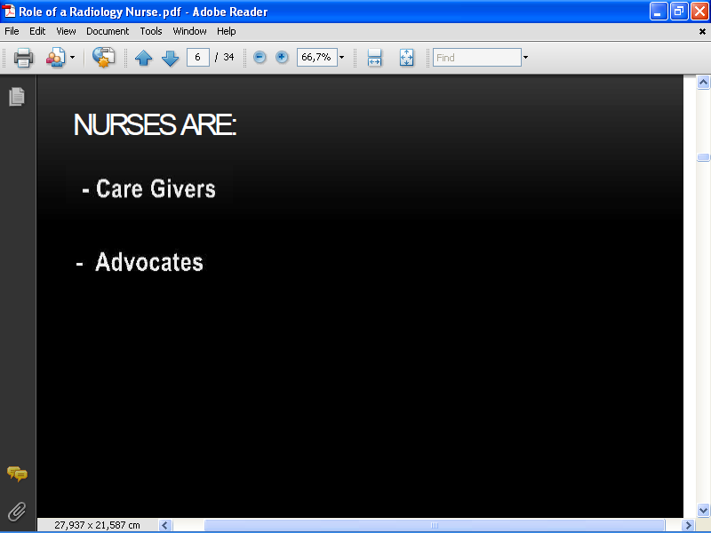

Slide 9
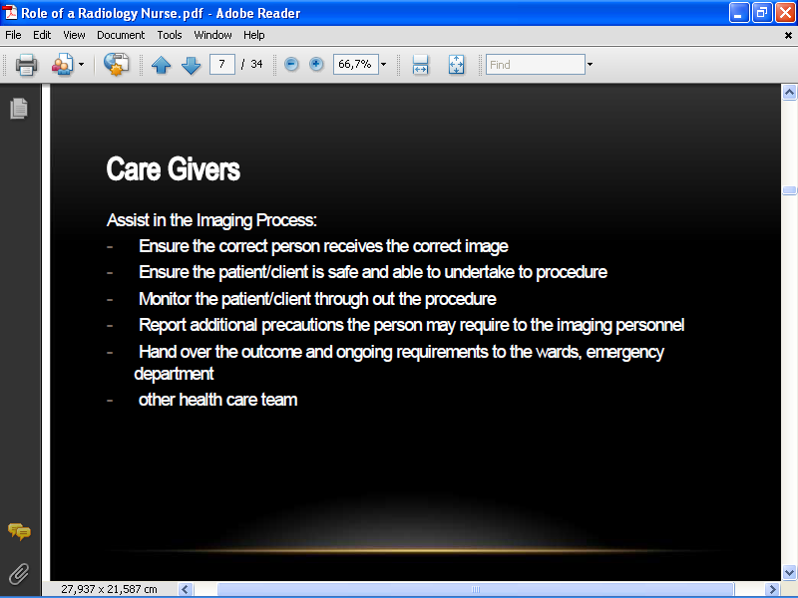

Slide 10
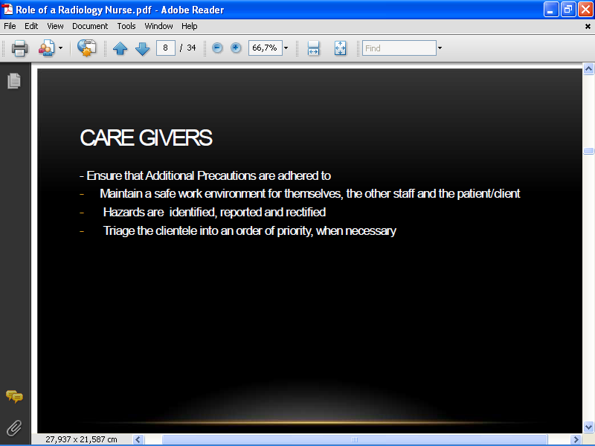

Slide 11
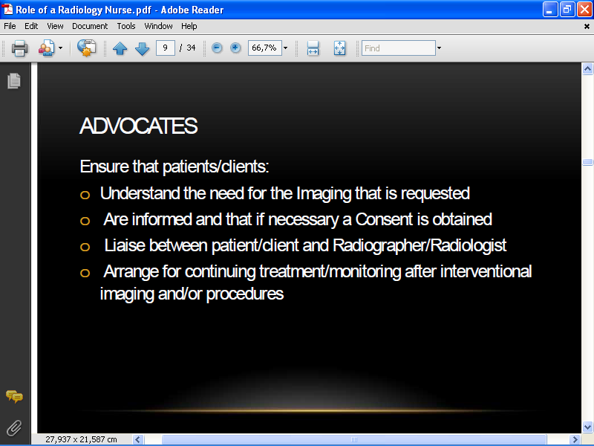

Slide 12
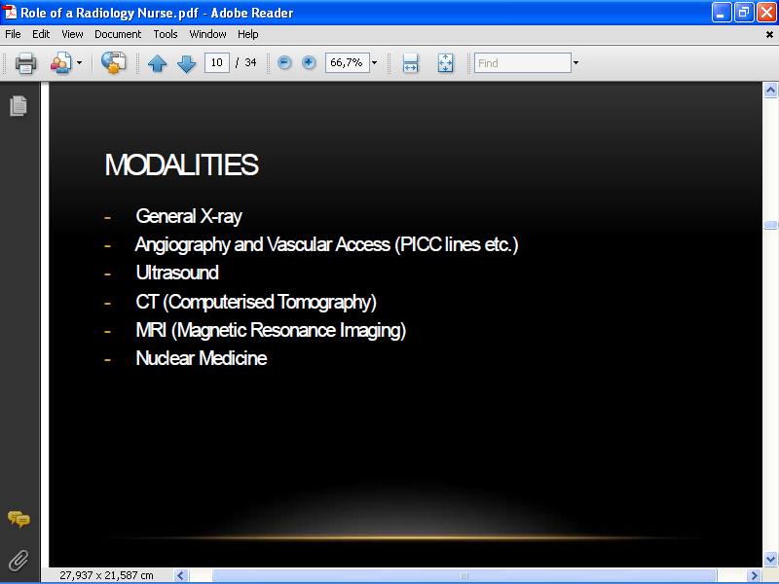

Slide 13
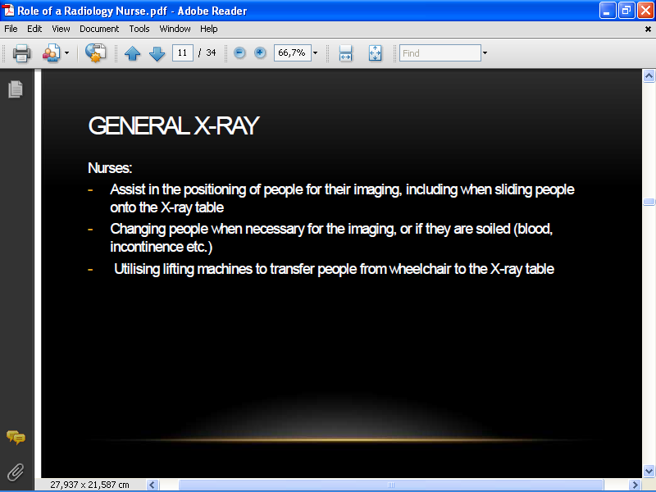

Slide 14
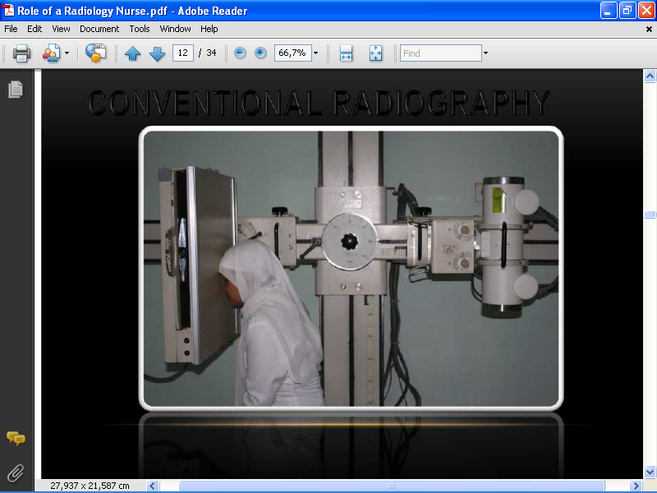

Slide 15
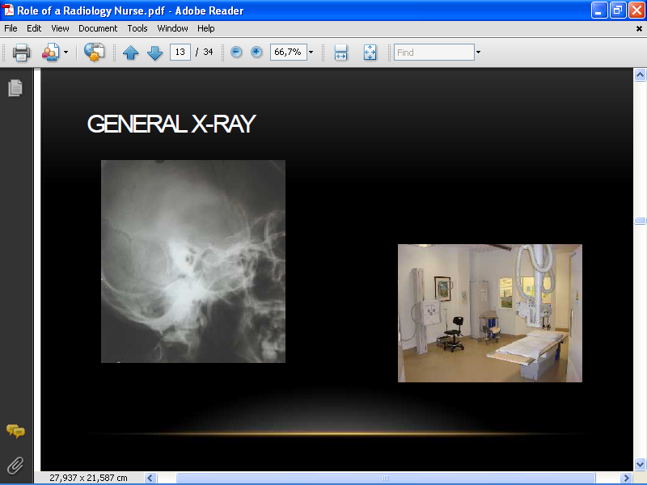

Slide 16
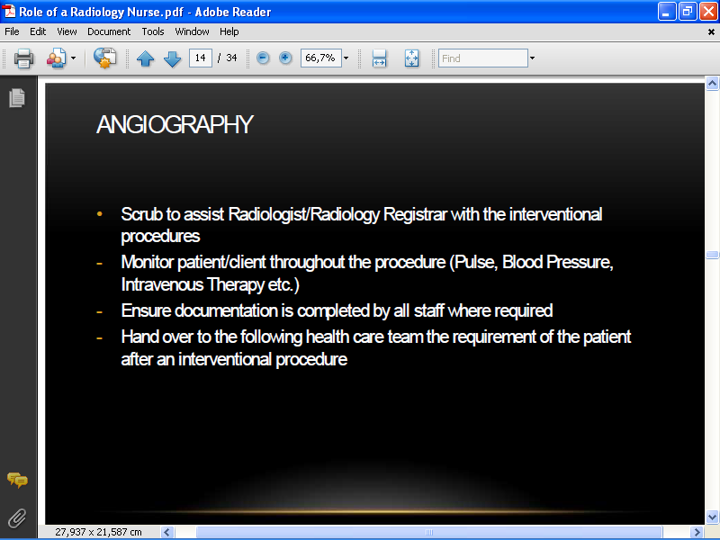

Slide 17
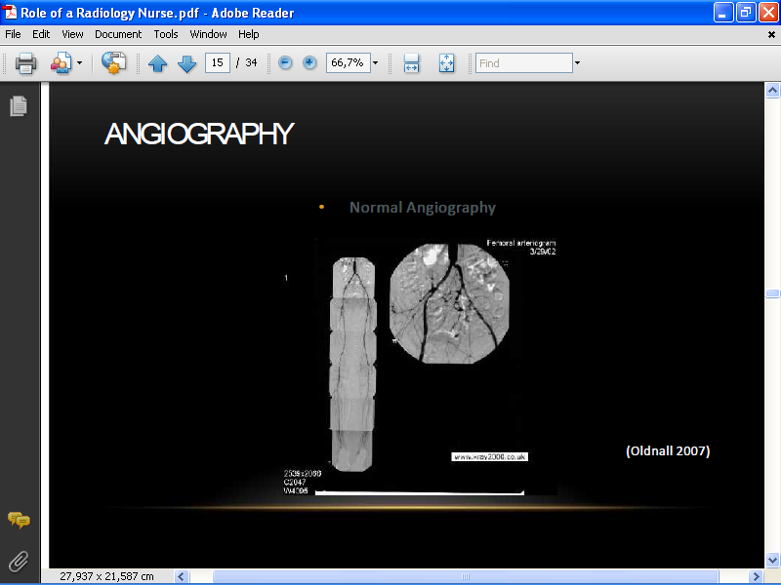

Slide 18
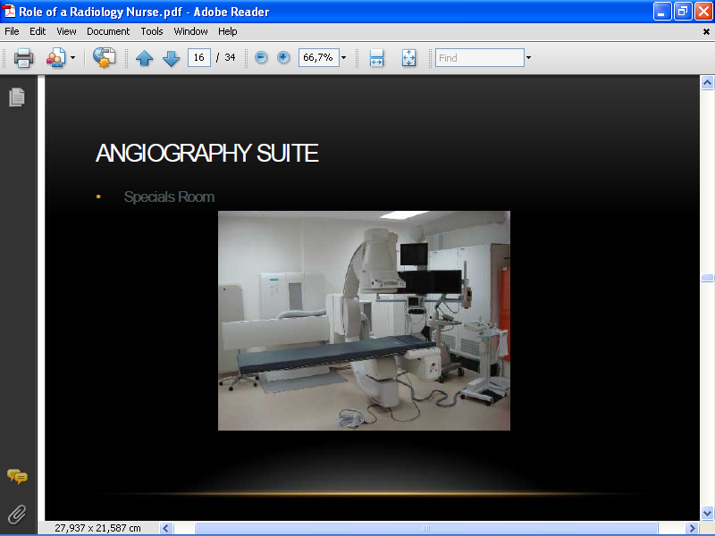

Slide 19
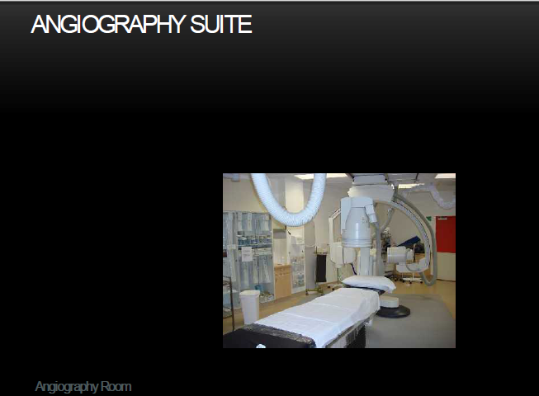

Slide 20
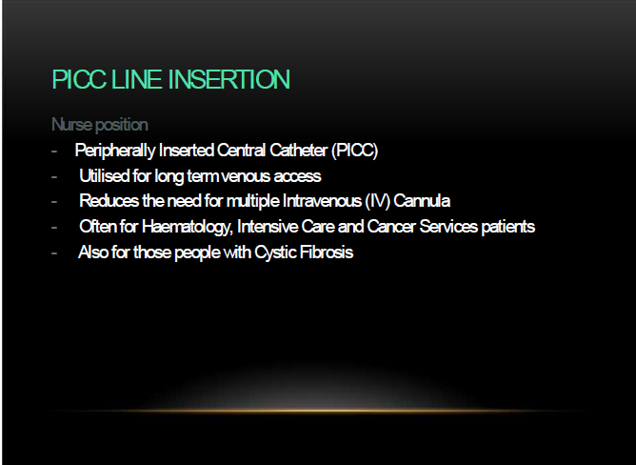

Slide 21
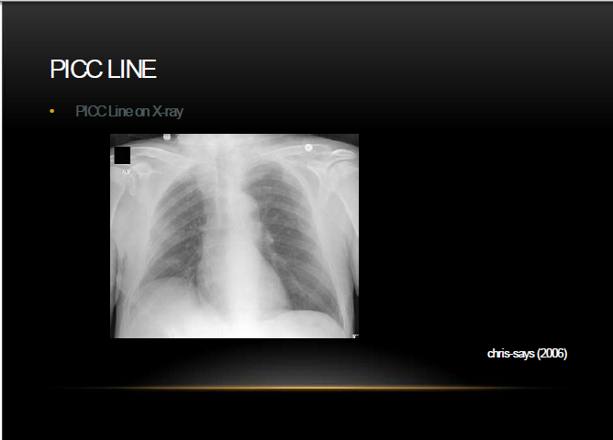

Slide 22
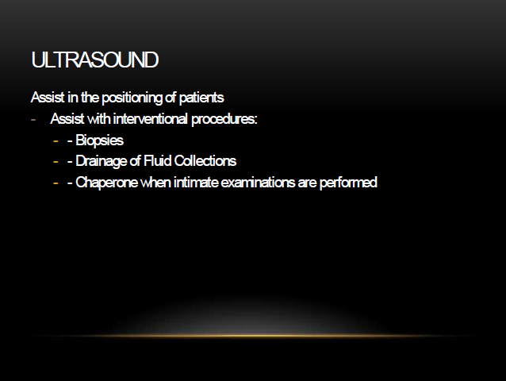

Slide 23
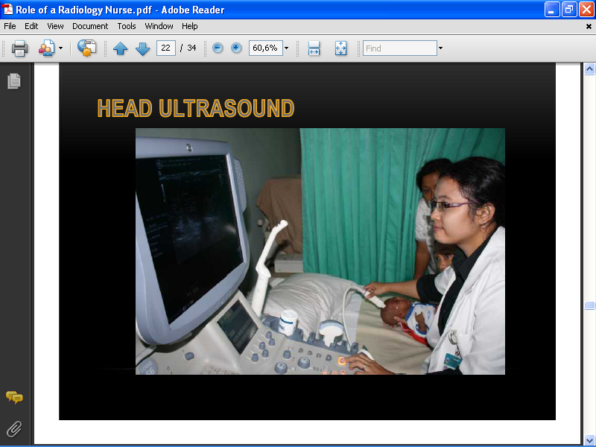

Slide 24
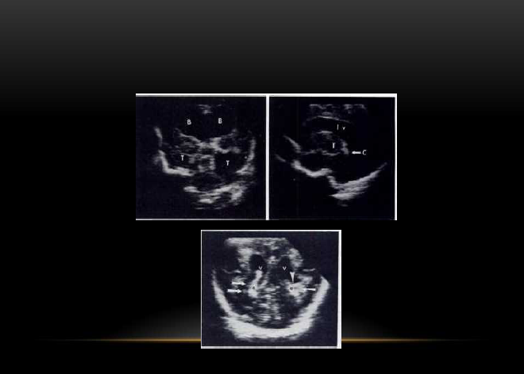

Slide 25
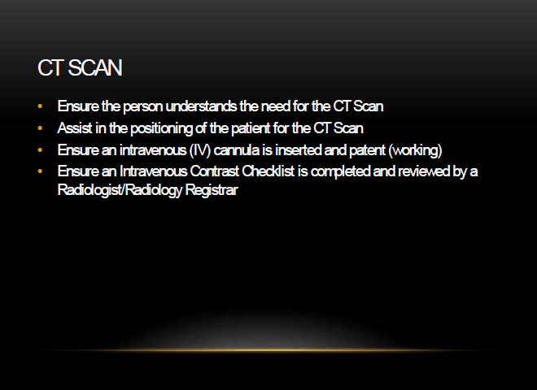

Slide 26
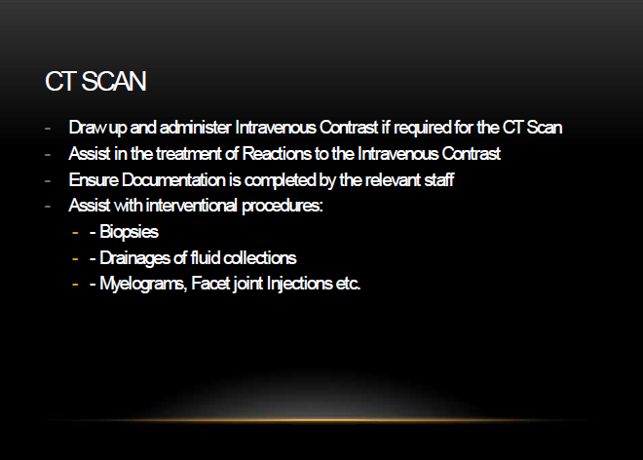

Slide 27
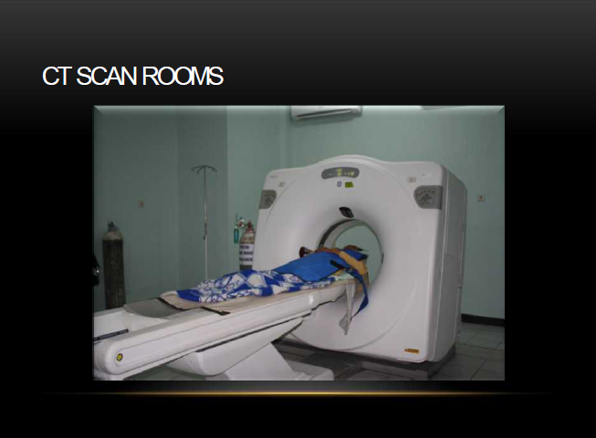

Slide 28
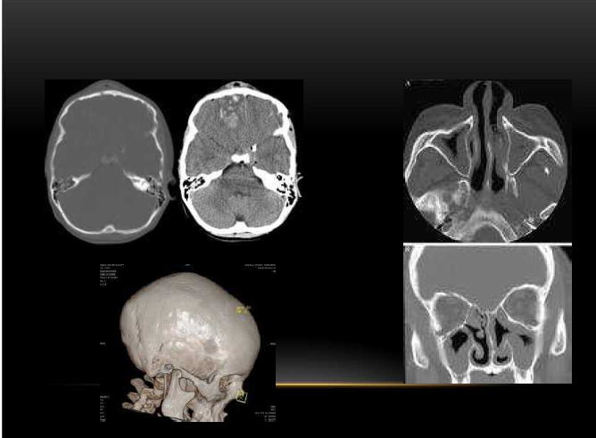

Slide 29
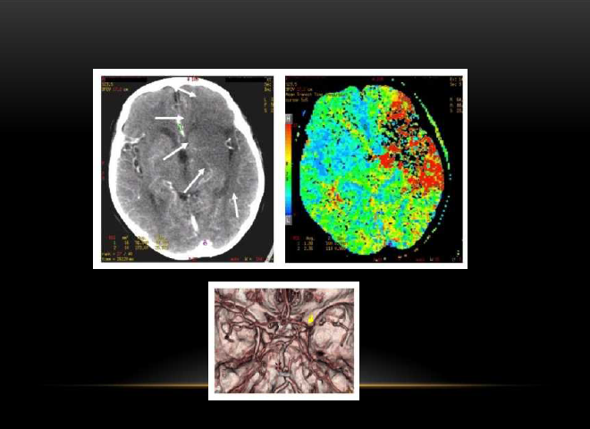

Slide 30
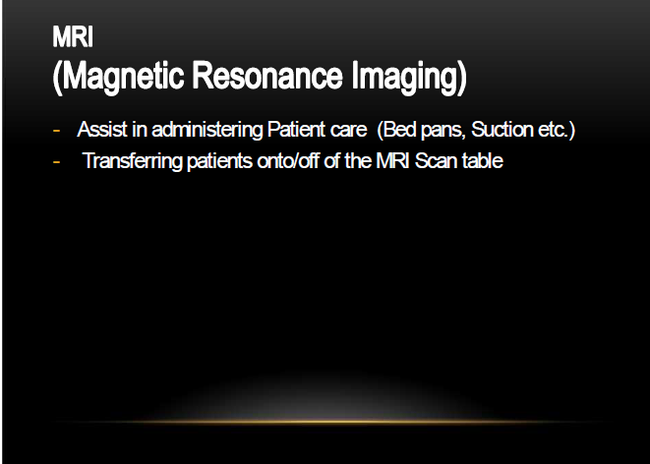

Slide 31
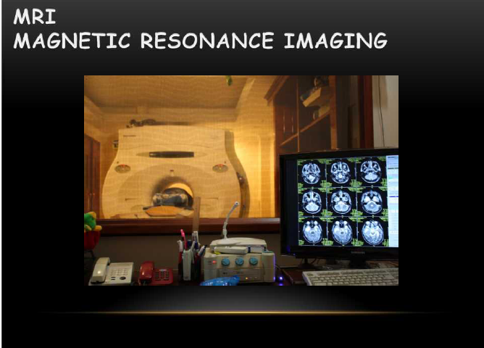

Slide 32
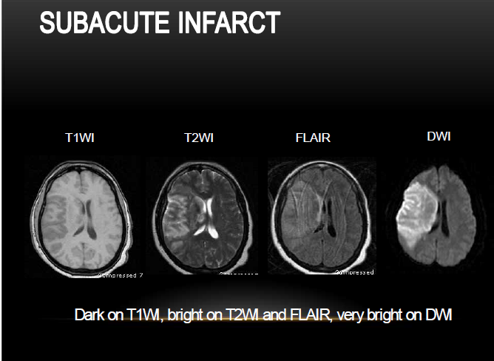

Slide 33
ANY QUESTION?
THANK YOU

